Slide 1
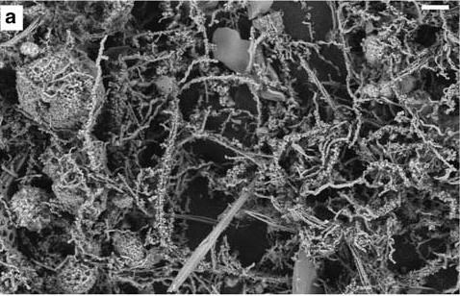
Iron-oxidizing bacteria in the deep ocean
Notes:
This PPT is aimed for chemistry, preferably a one year introductory general chemistry course. It can be used in conjunction with the “How to read and present a scientific paper” as it explains the major points of the primary article entitled “Ultra-diffuse hydrothermal venting supports
Fe-oxidizing bacteria and massive umber deposition at 5000m off Hawaii” by Edwards et al. (2011)

Slide 2
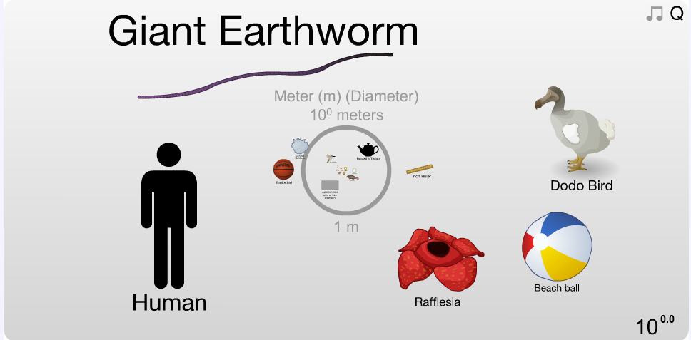
We live in a human-centric world.
Notes:
Here is an interactive website that can move you through the scale of small to large.
http://apod.nasa.gov/apod/ap120312.html
Explain sense of scale: We often see the world from our point of view. Humans are just a small fraction in the whole universe! In chemistry we look at atoms and molecules that are microscopic (10^-9 m). There is a large scale; things so small and too large to even imagine. You go from our size (order of meters) all the way down to the microscopic world. Even to smaller than an atom (smaller than nanometers!)! Alternatively, you can get really large … to the moon … pluto and beyond our universe and even galaxy.

Slide 3
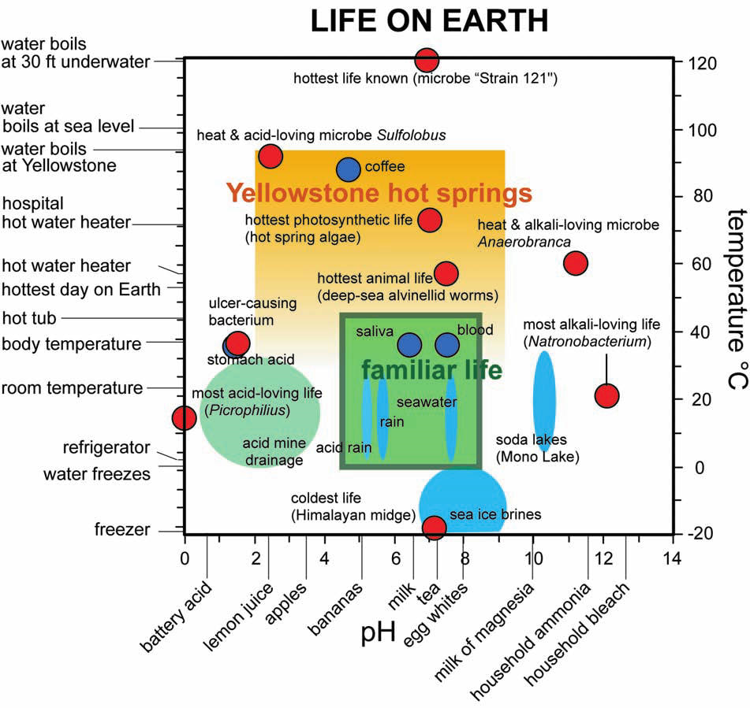
Life exists outside our box.
Subtitle
Text
Shock & Holland (2007)
Notes:
Not all organisms live inside our “little green box” or our ideal conditions.
What the point of this slide is: Life exists outside of our view of what life is. They live in chemical environments extremely different from us.
Some aspects that you can point out:
pH range from 0 to 14 very acidic to very alkaline
Temperature on the right and left
Very cold to very hot and very acidic to very alkaline
Familiar life in the green box—things we know and recognize as habitats
Other environments:
Acid mine drainage
Sea ice brines
Yellowstone hot springs
Soda lakes in the Eastern Sierra
And then the red dots—they represent organisms that we’ve found
At temperatures of -20 to 120 C—doesn’t water boil at 100C? Yes, but these organisms are under pressure
Strain 121 is the world record holder actual has an optimal growing temperature (grows best) at 105 C and can still grow at 121. It was grown in a sterilizer (autoclave) the kind of system used to sterilize tools. This organism is not a pathogen—we’re not compatible with it. We’re not hot enough!
And at high salt, it acts like an antifreeze so organisms can live in -20 because the freezing point has been so far lowered
Even organisms that live in negative pH. You’ve probably never heard of negative pH, but the lowest measured is a minus 3.5 or 3.6 and remember that pH is a log scale, not linear. So there are 14 orders of magnitude difference.
Pretty remarkable the extent of microbial life.
Researchers focus on Yellowstone (Shock and Holland, 2007)
3

Slide 4
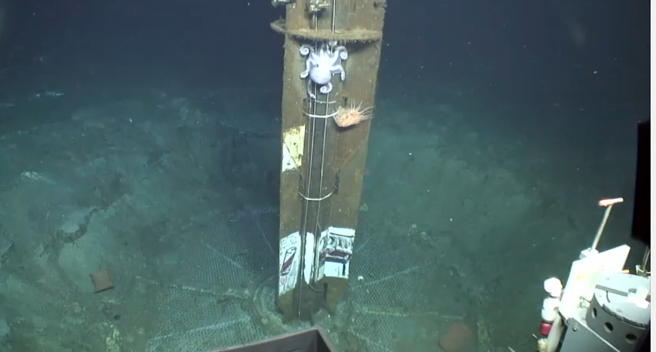
For example, there is life deep down on the ocean floor.
C-DEBI explores the deep ocean!
(Center for Deep Energy Biosphere Investigations)
Notes:
Talk about CDEBI
Watch the intro to C-DEBI video: https://www.youtube.com/watch?v=wiYzGL4iTY8&feature=youtu.be

Slide 5
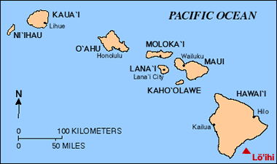
Scientists explored a site deep in the ocean called “FeMO deep”
near Lo’ihi volcano, Hawaii
5,000 mbsl (meters below sea level)
Hydrothermal vent: secretes chemicals including Fe and Mn
Ultra diffuse: leaks slowly over 1 km
Lo’ihi, Hawaii
Notes:
Scientists explored a site deep in the ocean that is near the big island of Hawaii. The site is called “FeMO” deep because it is rich in iron (Fe). Also, it is filled with microorganisms that oxidize this iron. It’s named for its discovery during the first Fe-Microbial Observatory expedition in 2006. It is 5,000 meters below sea level.
Lo’ihi Seamount, Hawaii is a ‘hot-spot’ volcano, meaning it has hot magma emerging from a particular spot below at the earth’s surface. Associated with this deep-sea volcanism is hydrothermal activity (Karl et al., 1988). Most hydrothermal activity occurs close to volcano summits, where significant thermal and chemical anomalies exist (Sakai et al., 1987) due to the intrusion of magma through the earth’s surface.
Lo’ihi Seamount (summit at 1000m below ocean surface) is a seismically active submarine volcano that represents an emerging Hawaiian Island (Klein, 1982; DeCarlo et al., 1983) This hydrothermal vent emits fluids near the summit of Lo’ihi that are rich in CO2, NH4, Si, Fe, alkalinity and Mn (Sedwick et al., 1992; Wheat et al., 2000). It leaks slowly and spreads out over 1 km on the ocean floor.

Slide 6
They found iron-oxidizing bacteria (FeOB)
Bacteria is called Zetaproteobacteria (ζ zeta)
Found in microbial mat called ‘Ula Nui’ (‘big red’)
‘Ula Nui’ is rich in Fe and Mn
‘Ula Nui’ microbial mat
iron
Fig. 1a (Edwards et al, 2011)
Notes:
At FeMO deep, scientists observed that there are bacteria called Zetaproteobacteria (ζ zeta) that feed off of the iron. It oxidizes the iron found at FeMO deep. So, FeMO deep has iron (Fe) and Maganese (Mn) present. The Mn is on the top surface and Fe below the surface. They call this an Fe mat and named it ‘Ula Nui’, (meaning ‘big red’ in Hawaiian). Ula Nui is characterized by a laminated, mineralized, cohesive crust of alternating Fe- and Mn-rich minerals draping between basalts (mineralized rocks), and cap the underlying gelatinous and Fe-rich mat.
Figure 7 of this paper shows the bacteria found here. The most prominent one is the Zetaproteobacteria (ζ zeta) that can oxidize the iron.

Slide 7
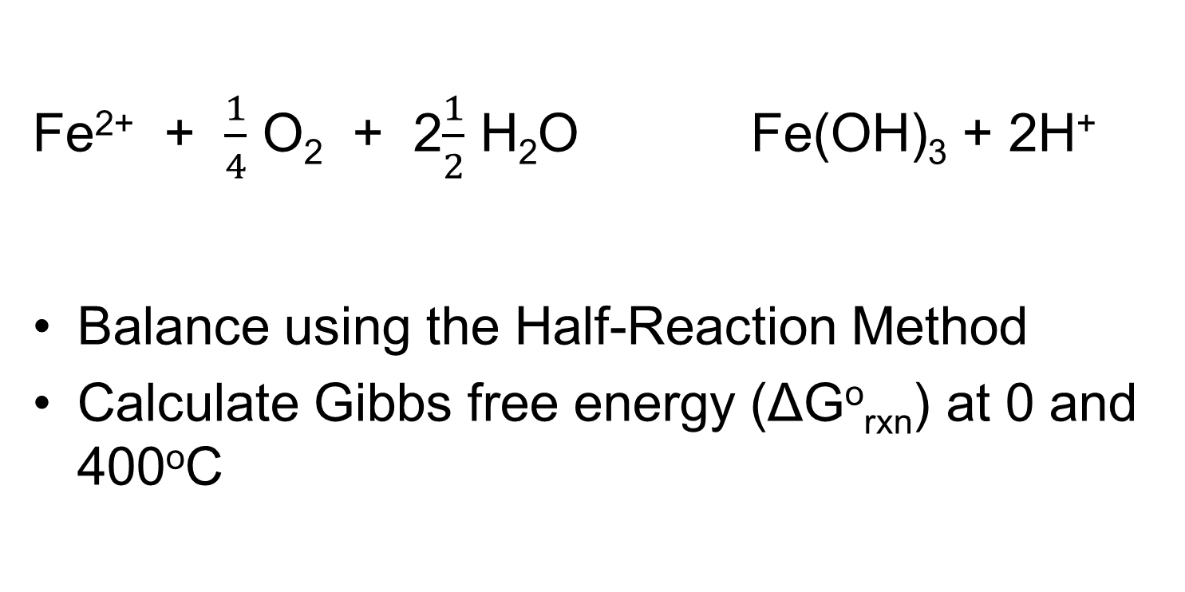
Redox reaction
Fe²⁺ + $\frac{1}{4}$ O₂ + 2$\frac{1}{2}$ H₂O Fe(OH)₃ + 2H⁺
Balance using the Half-Reaction Method
Calculate Gibbs free energy (ΔGº_{rxn}) at 0 and 400ºC
Notes:
The reaction of the bacteria oxidizing iron is a standard redox reaction as shown here. Students will need to balance this reaction using the half-reaction method. Then students will calculate Gibbs free energy at both 0 and 400ºC.

Slide 8
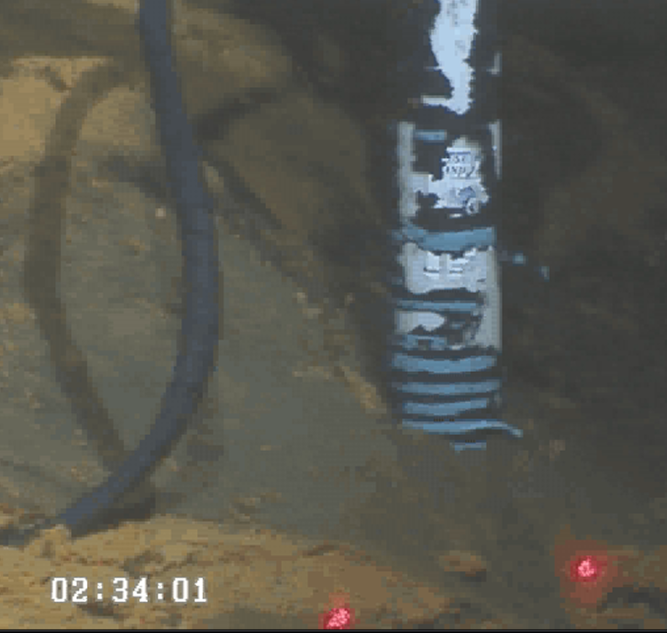
How did scientists get data?
Bring a ROV (‘Jason II’) to the ocean floor
Drill into ‘Ula Nui’ mat
Collect samples
Notes:
How did scientists even get this data that is 5,000 meters below the ocean surface? This video (FeMatROVsensor.avi) shows the method used. An ROV (remotely operated vehicle) named Jason II is lowered to the ocean floor. It drills into the Ula Nui mat and collects samples.
Lasers points in red give us a sense of scale (about 15 cm apart)

Slide 9
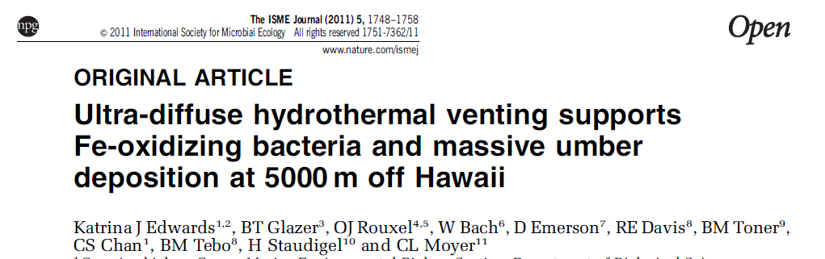
Your Assignment
Read “Ultra-diffuse hydrothermal venting supports Fe-oxidizing bacteria and massive umber deposition at 5000m off Hawaii” by Edwards et al. (2011)
Notes:
Watch overview of C-DEBI video: http://youtu.be/wiYzGL4iTY8
Present the PPT “How to read and present a scientific paper” to help students understand how to read original scientific papers (articles).

Slide 10
Your Assignment
Graph Figure 2 using the raw data provided
Balance redox reaction using the half-reaction method
Calculate Gibbs free energy (DGº_{rxn}) at 0ºC and 400ºC
Assemble a PPT presentation (6-10 slides) for this paper.
Notes:
Present the PPT “How to read and present a scientific paper” to help students present this paper.

