Slide 1
The Sub-Seabottom Biosphere
“It just screamed out that there had to be some kind of microbial community there to exploit the energy involved in this water–rock reaction”

Slide 2
Introduction to C-DEBI:
Center for Dark Energy Biosphere Investigations
Scientists that study the deep biosphere
Intro video: https://www.youtube.com/watch?v=6Hv_JF7_ECQ#t=168

Slide 3
C-DEBI Quote
“Here, we synthesize recent advances and discoveries pertaining to microbial activity in the marine deep subsurface, and we highlight topics about which there is still little understanding and suggest potential paths forward to address them.” (www.darkenergybiosphere.org).

Slide 4
Is there life beneath the surface of the ocean bottom?

Slide 5
History indicates life is possible beneath the seafloor
The existence of possible living organisms so deep beneath the seafloor was 1st realized 1920s from studies of bacteria from oil well drill fluids

Slide 6
Chemical reactions also led to an indirect realization of life there.
If there existed aquifers beneath the seafloor through which fluids circulated, chemical reactions had to be occurring between the seawater and the rocks
Those chemical reactions could sustain in situ life

Slide 7
Also, ocean cores gave evidence of life.
Bartholomew, JW and Rittenberg, SC, Thermophilic bacteria from deep ocean bottom cores, J Bacteriol. (1949) 57, 658.

Slide 8
So, what is the logic in analyzing cores?
The burial of sinking carbon model
Carbon sinks from the surface and lands on seafloor sediment.
Since sediment is also ‘snowing’ onto the seafloor, the carbon and sediment snow are co-buried, and pushed further down by newer material landing over it.

Slide 9
What have the cores revealed?
A diversity of living microorganisms and remnants of organisms
  They operate at an extremely slow rate.
  They appear to have longevity – tens of thousands of years.

Slide 10
What is this slow rate?
Bacteria with the longest lifespan, found ~ 2.5 Km beneath the seafloor, appear to be dividing once every 10,000 years
It is estimated that their ‘ages’ are on the order of 100 million years [MY]

Slide 11
The relevance of slow rates is that it alters the planet’s chemistry.
The overall slow pace notwithstanding, these deep sediment microbial communities could be altering
The chemistry of deep Earth.
The chemistry of rocks they are in contact with
The global carbon cycle and, by extension.
The planet itself

Slide 12
Questions arise about these microbial communities.
Are they ‘really’ alive in these conditions that, classically, would be regarded as infelicitous for living organisms?
If so, how do they survive in such extremes?
Can an evolutionary tree be developed?

Slide 13
What are the quantity and concentration of these microbial communities?
Putatively nearly 1/3 of the biomass of the Earth may be located in sub-seafloor sediments (Whitman et al., PNAS, 1998).
The numbers are vast, but the concentrations are low (1,000/ml) compared to 3 to 6 orders of magnitude more in terrestrial soil samples from the surface.
Whitman, WB, Coleman, DC, and Wiebe, WJ, Prokaryotes: The unseen majority, PNAS, 95, 6578–6583 (1998)

Slide 14
What depth range do these microbial communities live at?
As cores are obtained from greater distances beneath the seafloor, organisms continue to be found.
Thus, to date, a maximum distance, and therefore, an oldest age have not been established

Slide 15
Are there limits for these microbial communities?
Limiting factors could be
Meeting energy demand
Physical factors that could set a limit?
  Distance beneath the seafloor?
  Temperature?
  Pressure?

Slide 16
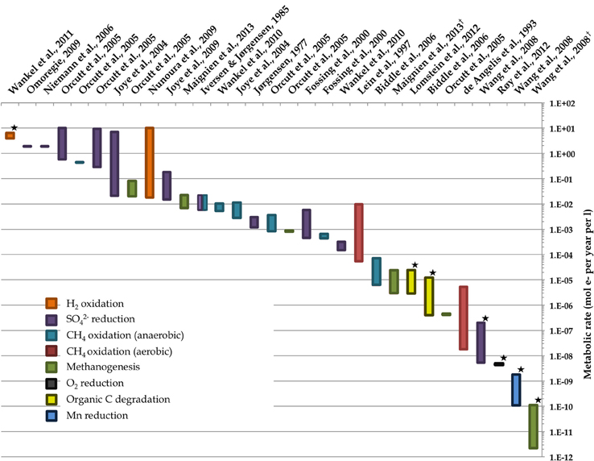
Are these microorganisms really alive?
Or are they simply in extremis?
The extremely low metabolic rates of long-lived bacteria does bring up the question ‘Is this life’?
Oroutt et. al. (2013)

Slide 17
What other life forms exists in the deep biosphere?
Viruses and fungi
  Apparently they are even more abundant (Engelhardt)
  Encountered in all sediment samples ranging up to 100 million years old
Engelhardt, T, Kallmeyer, J, Cypionka, H, Engelen, B, High virus-to-cell ratios indicate on-going production of viruses in deep subsurface sediments. ISME J, 8, 1503–1509 (2014)

Slide 18
Is the deep biosphere alive?
Evidence indicates yes!
It is a reservoir for such a massive carbon biomass.
It is not just a collection of buried, non-functioning microbial cells.

Slide 19
The deep biosphere is diverse.
    There are a diversity of habitats and inhabitants.
Microbial habitats are highly distributed in
    Sediment
    Pore waters
    Upper basaltic crust and
    Fluids that circulate throughout
Conditions include wide range of temperature, pressure, pH, and redox conditions exists

Slide 20
There are impacts of the deep biosphere.
It could serve as an evolutionary forcing.
It affects carbon and nutrient cycling.
It alters gradients on spatial scales ranging from millimeters to kilometers.
It could have global biogeochemical roles

Slide 21
So far, scientists discovered that …
‘Live’ microbes exist more than 500 feet beneath the seafloor. (Biddle et. al. 2012)
Microbes are alive despite conditions that would be considered extreme (high pressure, no oxygen, minimal nutrients).
Microbes are reproducing with cell division, assimilating energy and moving around.
Biddle, JF, et al., Prospects for the study of evolution in the deep biosphere, Front. Microbiol., 24 January 2012 | doi: 10.3389/fmicb.2011.00285

Slide 22
So far, scientists discovered that …
Metabolic pathways require sulfate and nitrate reducing enzymes to generate molecules that store energy
Notes:
Considered the primary source of energy production by microbes in this zone
Evidence indicates that nitrate reduction could be have important inputs to their energy profile.
Dead microbes – autochtonous?
Thought to be autochtonous, or from matter drifting from surface.
This is a hard one as it would imply independent evolution.

Slide 23
So far, scientists discovered that …
mRNAs coding for the enzymes involved in the above pathways must be present

Slide 24
Scientists made these discoveries using genetic material.
Genetic material recovered from deep ocean mud revealed an ecosystem of active bacteria, fungi and other microscopic organisms 5 MYA.
Amino acids beneath the seafloor are from cells that are either living there or have died there and contribute to nitrogen and carbon sources.

Slide 25
Scientists made these discoveries using genetic material.
Total mRNA was extracted, the first successful “metatranscriptome,” from the deep below the seafloor.
mRNA is good evidence that there are live cells, as it would signal that protein synthesis is taking place.

Slide 26
Many challenges remain in understanding microbial communities in the deep biosphere.
What is their impact on the biogeochemical cycles?
What is the diversity of the microbial community?
What are the rates of microbial activity?

Slide 27
Scientists conducted research to answer these questions.
You read three abstracts which summarized the studies of these scientific research groups.
Data collected from genetic material of microorganisms from cores in the deep biosphere address these questions

Slide 28
1. What is their impact on the biogeochemical cycles?
Steffen Leth Jorgensen et. al. (2012) showed that prokaryotic microbial communities correlated with the geochemistry of the sediments in the Artic.
Jorgensen, SL, et al., Correlating microbial community profiles with geochemical data in highly stratified sediments from the Arctic Mid-Ocean Ridge, PNAS, 109, E2846–E2855 (2012)

Slide 29
2. What is the diversity of the microbial community?
Inagaki et. al. (2003) discovered two distinct sediment layers giving rise to different habitats and microorganisms
Inagaki, F, et al., Sulfurimonas autotrophica gen. nov., sp. nov., a novel sulfur-oxidizing e-proteobacterium isolated from hydrothermal sediments in the Mid-Okinawa trough, Inter J System Evol Microbiol , 53, 1801–1805 (2003)

Slide 30
3. What are the rates of microbial activity?
Orsi et. al. (2013) documented rates of cell division across all three domains of life (bacteria, archaea, eukarya) in the deep biosphere indicating overall microbial activities.
Orsi, WD, et al., Gene expression in the deep biosphere, Nature, 499, 205-208 (2013)
Notes:
Quantifying the microbial activity rates remains a challenge
However these rates are needed to understand
The coupling of sub-seafloor ecosystems with global biogeochemical cycles
The ‘hows’ of the survival of the microorganisms in such “extremes”

Slide 31
Life in the Sub-Seabottom Biosphere
“By the time you get 100 meters down, the bacteria are eating the leftovers of the leftovers of the leftovers of the leftovers — and they are still yummy for bacteria.” (Biddle, 2012)

