Slide 1
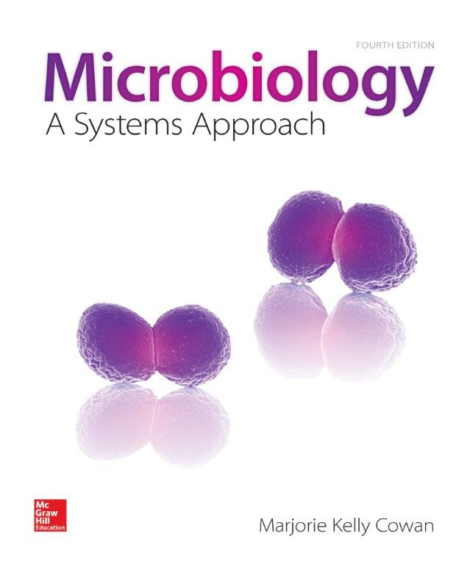
Host Microbe Interactions
Copyright © McGraw-Hill Education. Permission required for reproduction or display.
Notes:
This lecture is designed for Microbiology for Health Science Majors

Slide 2

What is CDEBI
https://www.youtube.com/watch?v=8sSN1psBeXk
Let me introduce Lily Momper
https://meet94883045.adobeconnect.com/nov18/
Notes:
http://youtu.be/wiYzGL4iTY8: shorter CDEBI introduction science only

Slide 3
The Human Host

Slide 4
The Good - Resident Biota
Normal biota:
Large and diverse collection of microbes living on and in the body
Resident or indigenous biota
Include bacteria, fungi, protozoa and viruses
These organisms have a profound effect on human biology
Notes:
Recall the good about microbes

Slide 5
The Human Microbiome Project
Preliminary results:
10 X more microbes that human cells
Human cells contain 22,000 protein encoding genes; microbes that inhabit humans contain 8 million
Most are good
All healthy people harbor potentially dangerous pathogens, but in low numbers
http://www.npr.org/blogs/health/2013/11/18/244526773/gut-bacteria-might-guide-the-workings-of-our-minds

Slide 6
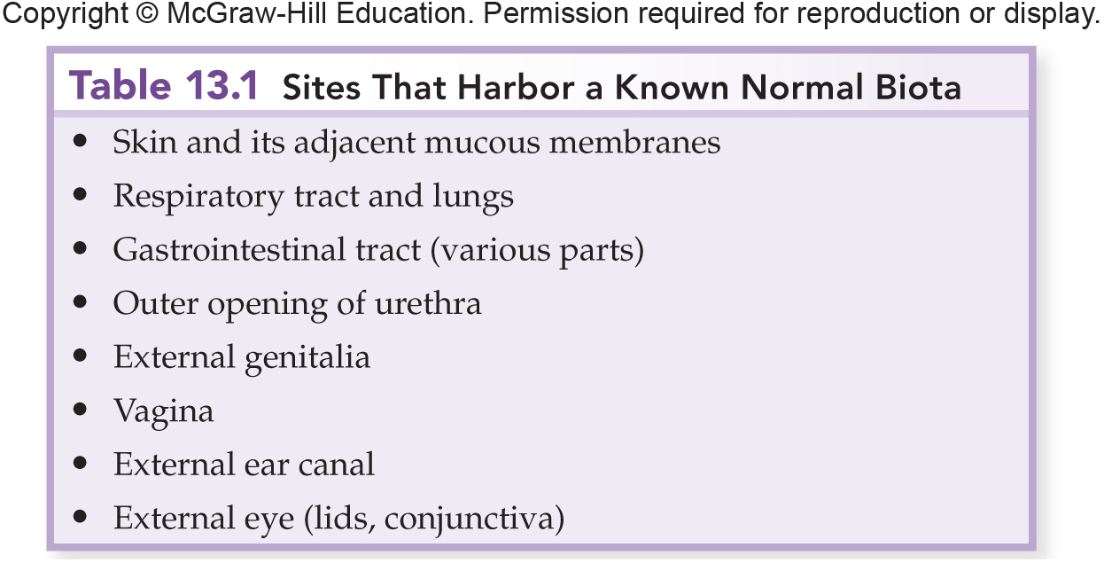
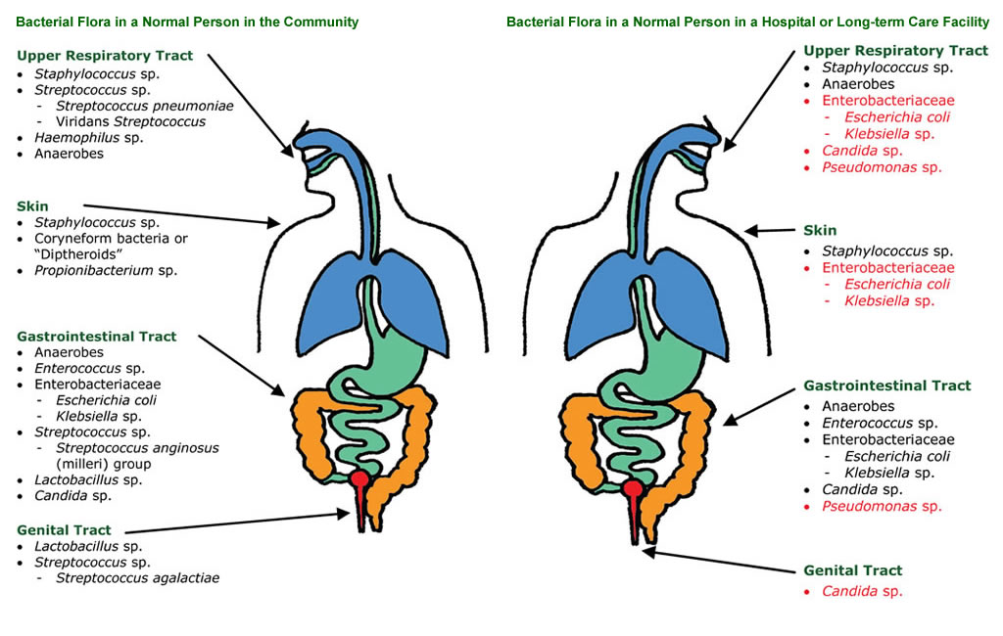
Acquiring Resident Biota

Slide 7
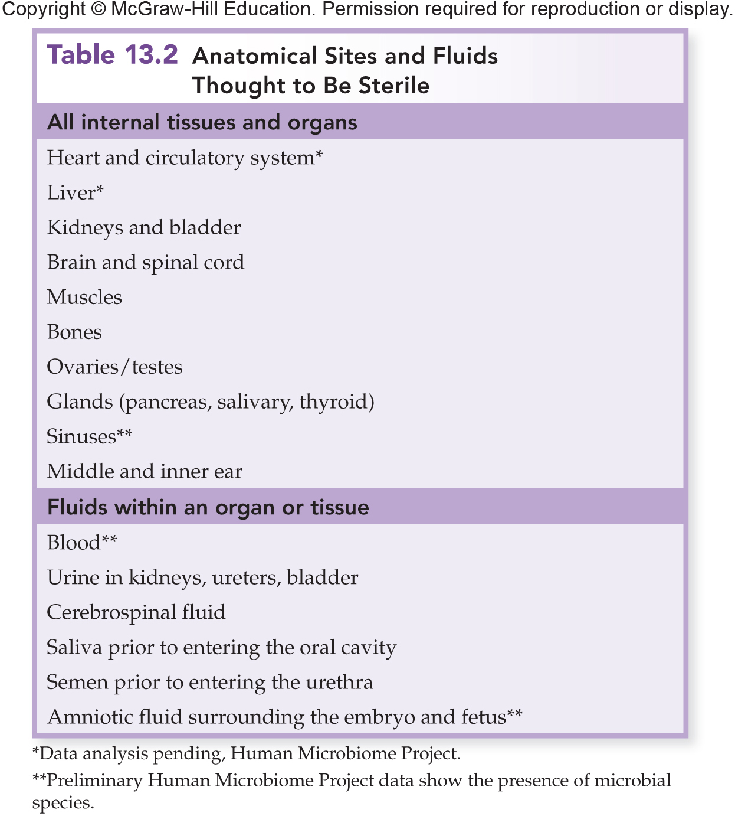
Acquiring Resident Biota

Slide 8
Initial Colonization of the Newborn
Continued through diet:
Breast milk contains around 600 species of bacteria and sugars that babies cannot digest
Sugars used by healthy gut bacteria
Breast milk may be necessary for maintaining a healthy gut microbiome in the baby

Slide 9
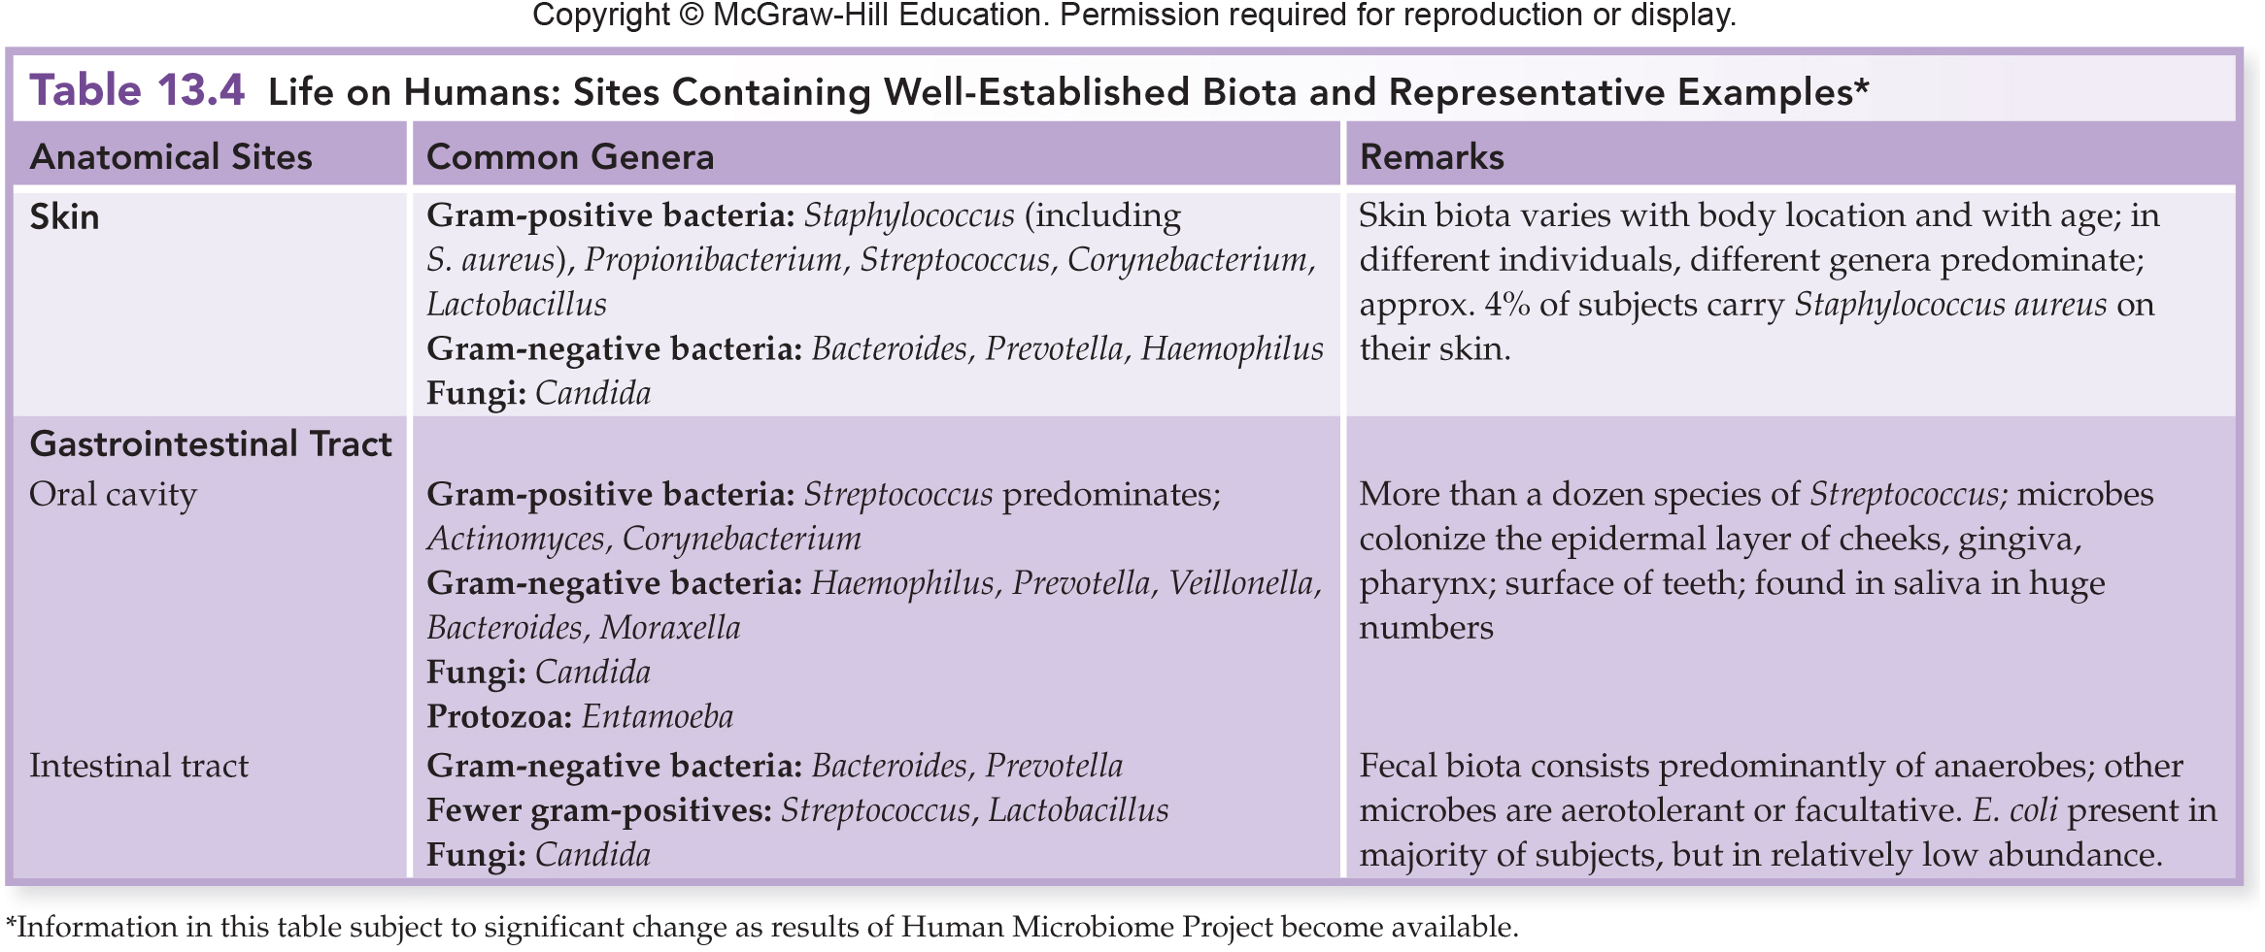
Indigenous Biota of Specific Regions

Slide 10
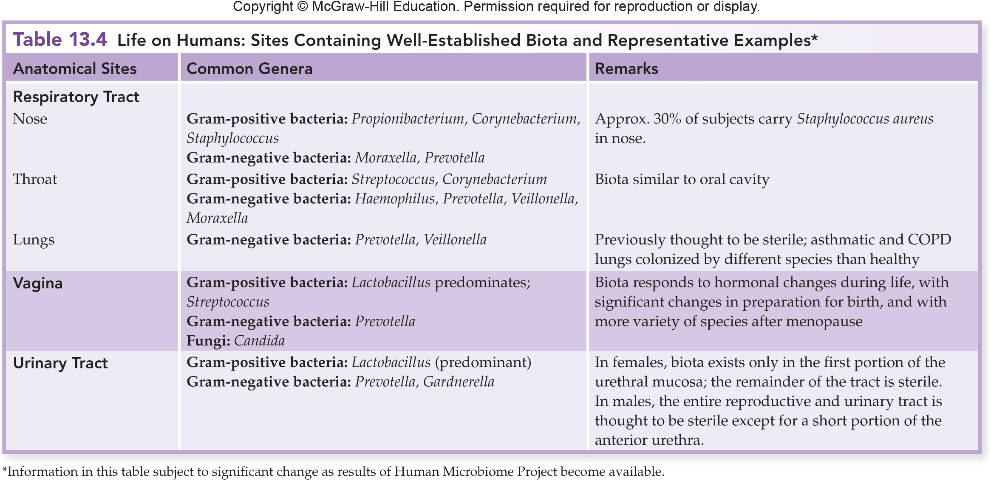
Indigenous Biota of Specific Regions

Slide 11
The Bad: Colonization, Infection, Disease
Infection:
Pathogenic microorganisms penetrate host defenses, enter the tissues, and multiply
Pathologic state:
Cumulative effects of infection damage
Disruption of tissues and organs
Results in disease
Notes:
The Bad about microbes

Slide 12
The Bad: Colonization, Infection, Disease
Disease:
Any deviation from health
Factors that cause disease:
Infections
Diet
Genetics
Aging
Infectious disease:
Disruption of tissues or organs caused by microbes or their products
http://news.sciencemag.org/health/2014/11/mysterious-sea-star-killer-probably-virus

Slide 13
The Progress of an Infection

Slide 14
The Progress of Infection
Pathogen:
A microbe whose relationship with its host is parasitic
Results in infection and disease
Type and severity of infection depend on both the pathogenicity of the organism and the condition of the host

Slide 15
The Progress of Infection
Pathogenicity:
Describes an organism’s potential to cause infection or disease
True pathogens:
Capable of causing disease in healthy persons with normal immune defenses
Opportunistic pathogens:
Cause disease when:
The host’s defenses are compromised
When they become established in a part of the body that is not natural to them

Slide 16
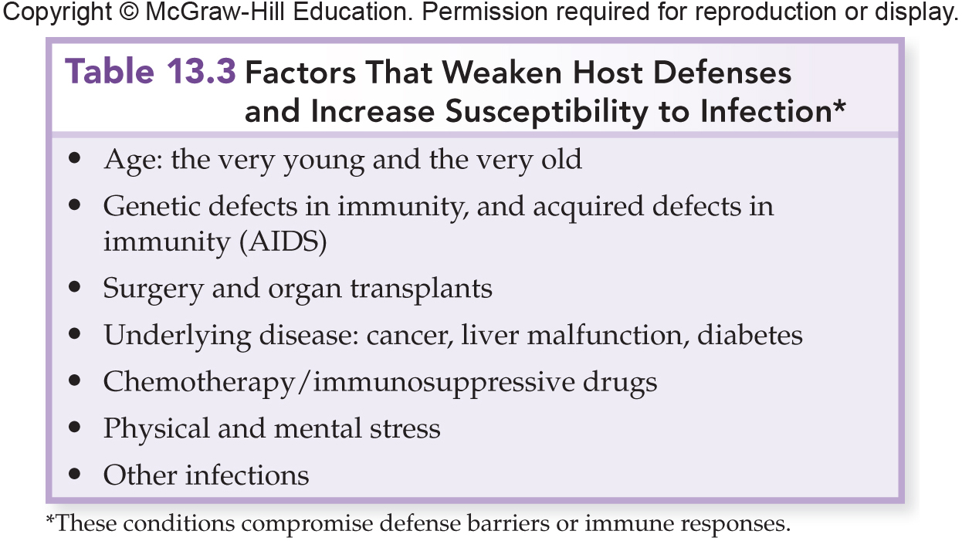

Slide 17
The Progress of Infection
Virulence:
The relative severity of the disease caused by a particular microorganism
Virulence factor:
Any characteristic or structure of the microbe that contributes to toxin production or induction of an injurious host response

Slide 18
The Progress of Infection
Biosafety Levels (BSL):
A system of biosafety categories adopted by the Centers for Disease Control and Prevention (CDC)
Based on the general degree of pathogenicity and the relative danger in handling these pathogens

Slide 19
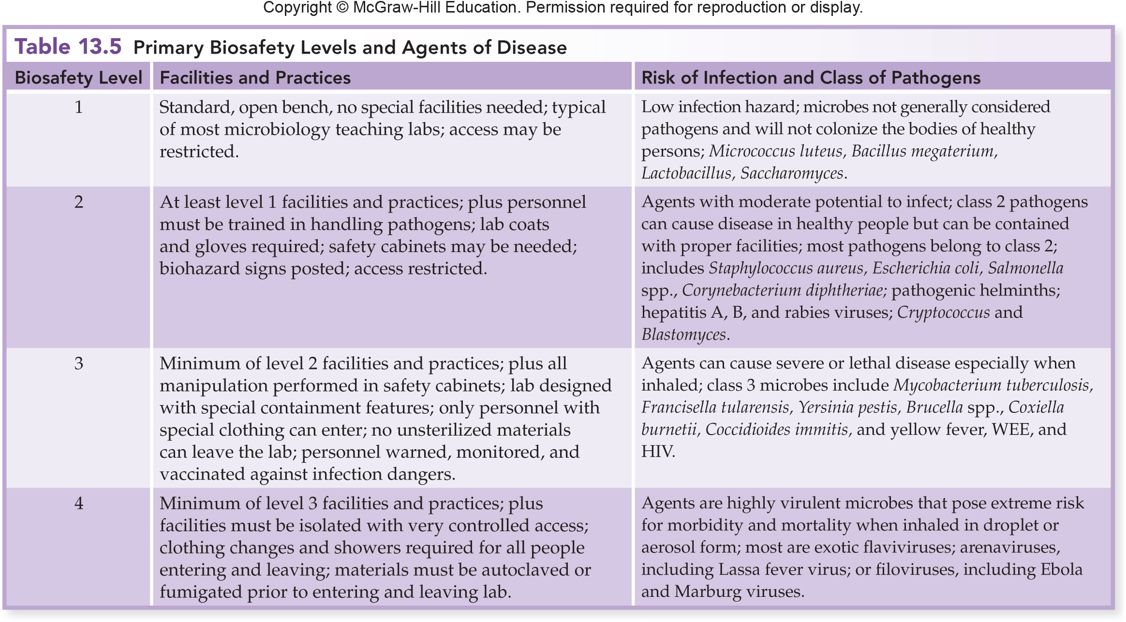
The Progress of Infection

Slide 20
Becoming Established: Step One – Portals of Entry
Portal of entry:
A characteristic route taken by a microbe to initiate infection
Usually through skin or mucous membranes
Exogenous: originating from outside the body
The environment, another person, or animal
Endogenous: already existing in the body
Normal biota or a previously silent infection

Slide 21
Skin
Sites of entry:
Nicks
Abrasions
Punctures
Conjunctiva
Intact skin - very tough barrier

Slide 22
The Gastrointestinal Tract
Entry through
food
drink
other ingested substances
Adapted to survive digestive enzymes and abrupt pH changes

Slide 23
Respiratory System
Openings to the respiratory tract:
Oral cavity
Nasal cavity
Continuous mucous membrane
Upper respiratory tract, sinuses, and auditory tubes.
Microbes often transferred from one site to another

Slide 24
Urogenital System
Sexually transmitted infections (STIs):
Account for 4% of infections worldwide
13 million new cases in the U.S. each year
Entry points through the skin or mucosa of:
Penis
External genitalia
Vagina
Cervix
Urethra

Slide 25
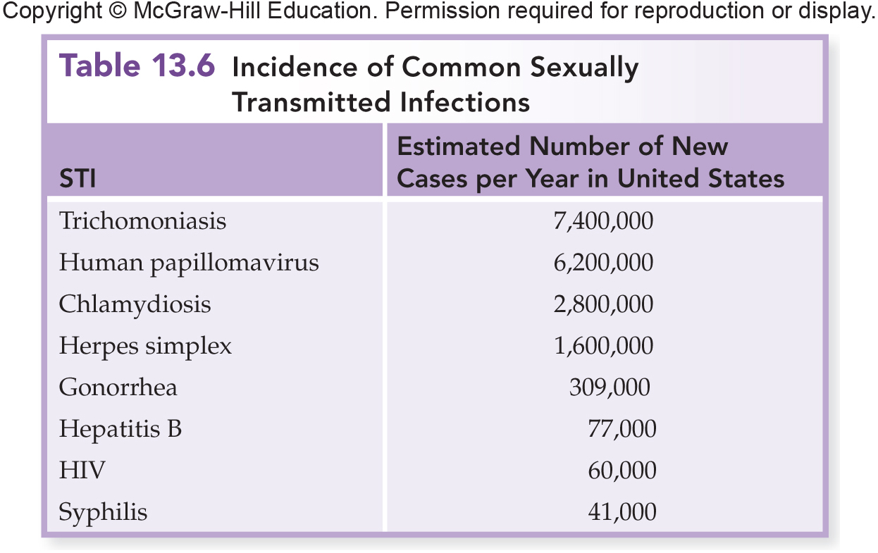
Urogenital Portals of Entry

Slide 26
Pathogens That Infect During Pregnancy and Birth
The placenta is an exchange organ:
Maternal and fetal tissues
Separates mother and baby’s blood
Permits diffusion of dissolved nutrients and gases to the fetus
A few microbes cross the placenta and are spread by the umbilical vein into the fetal tissues.
Pathogens can be transmitted perinatally as the child passes through the birth canal.

Slide 27
Pathogens That Infect During Pregnancy and Birth
TORCH: common infections of the fetus and neonate.
Toxoplasmosis
Other diseases: syphilis, coxsackievirus, varicella-zoster virus, AIDS, chlamydia
Rubella
Cytomegalovirus
Herpes simplex virus

Slide 28
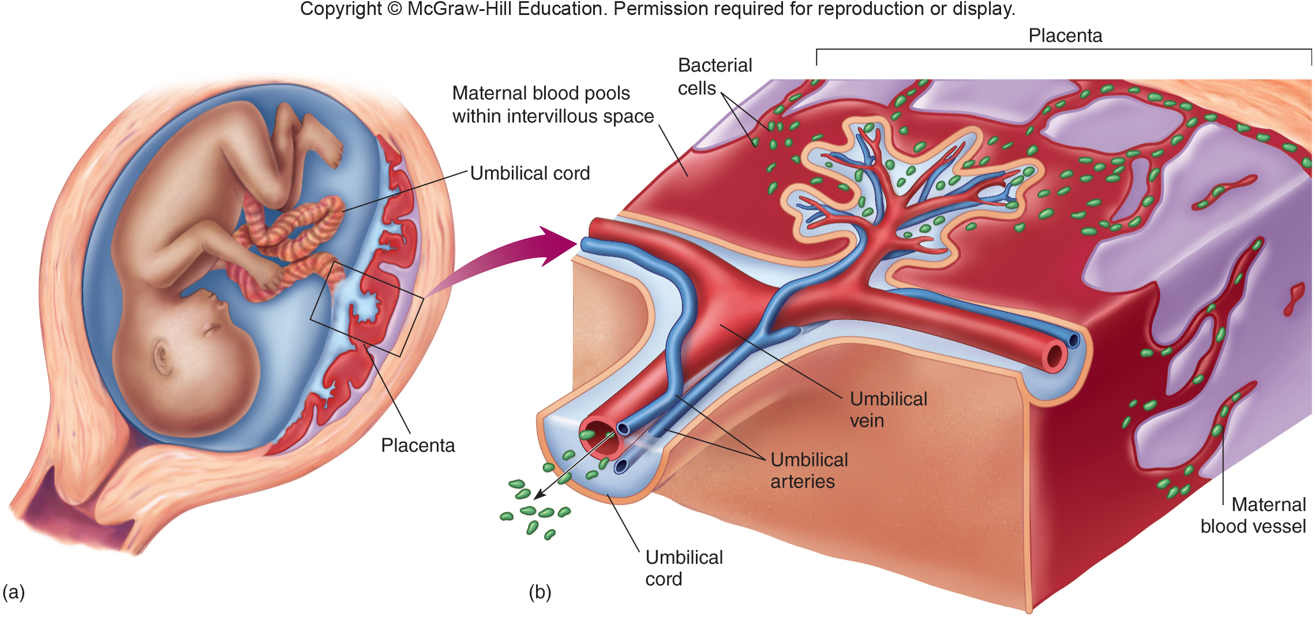
Pathogens That Infect During Pregnancy and Birth

Slide 29
The Size of the Inoculum
Infectious dose (ID): a minimum number of microbes required for an infection to proceed
Determined experimentally for many microbes
Microbes with a smaller infectious dose have greater virulence

Slide 30
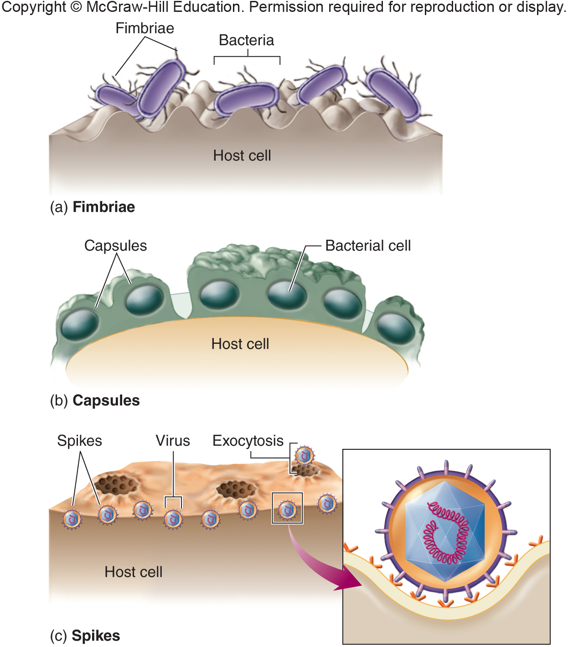
Becoming Established: Step Two – Attaching to the Host
Adhesion:
Microbes - stable foothold on host tissues
Binding between specific molecules on both the host and pathogen
A particular pathogen is limited to only those cells and organisms to which it can bind
Once attached, a pathogen can invade body compartments

Slide 31
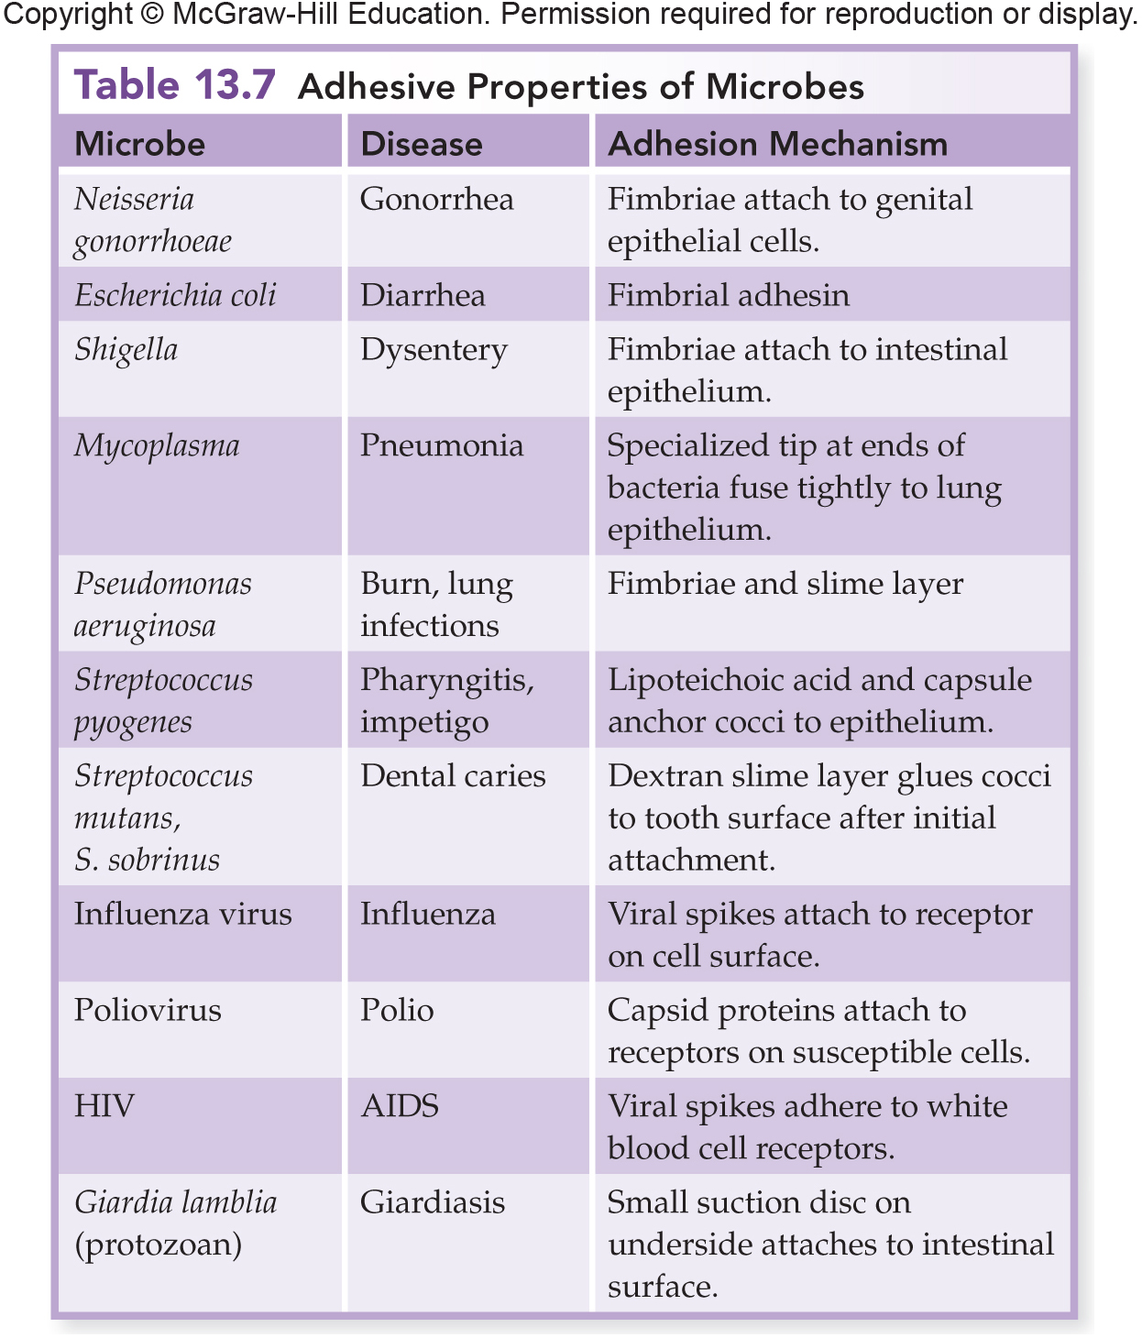
Attaching to the Host

Slide 32
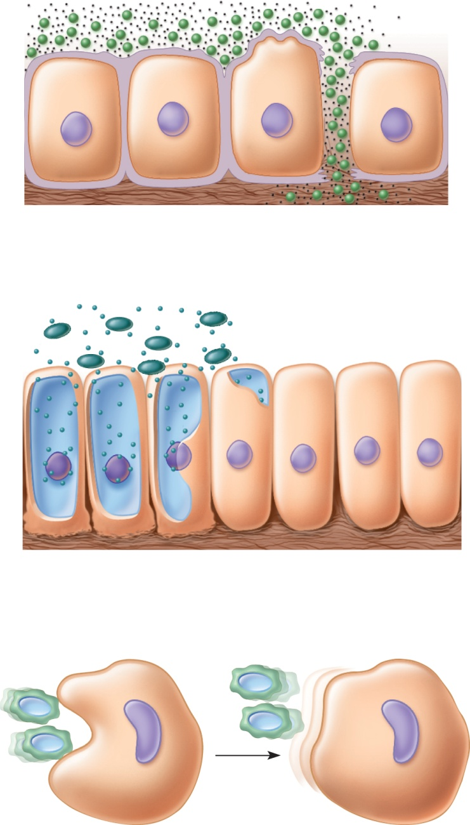
Becoming Established: Step 3 – Surviving Host Defenses
Phagocytes:
White blood cells that engulf and destroy pathogens
Antiphagocytic factors:
Used by pathogens to avoid phagocytes
Leukocidins
Capsules
Survive after engulfed

Slide 33
Step Four: Causing Disease
Virulence factors:
Structures, products, or capabilities that allow a pathogen to cause infection in the host
Adaptations that a microbe uses to invade and establish itself in a host
Determine the degree of tissue damage that occurs

Slide 34
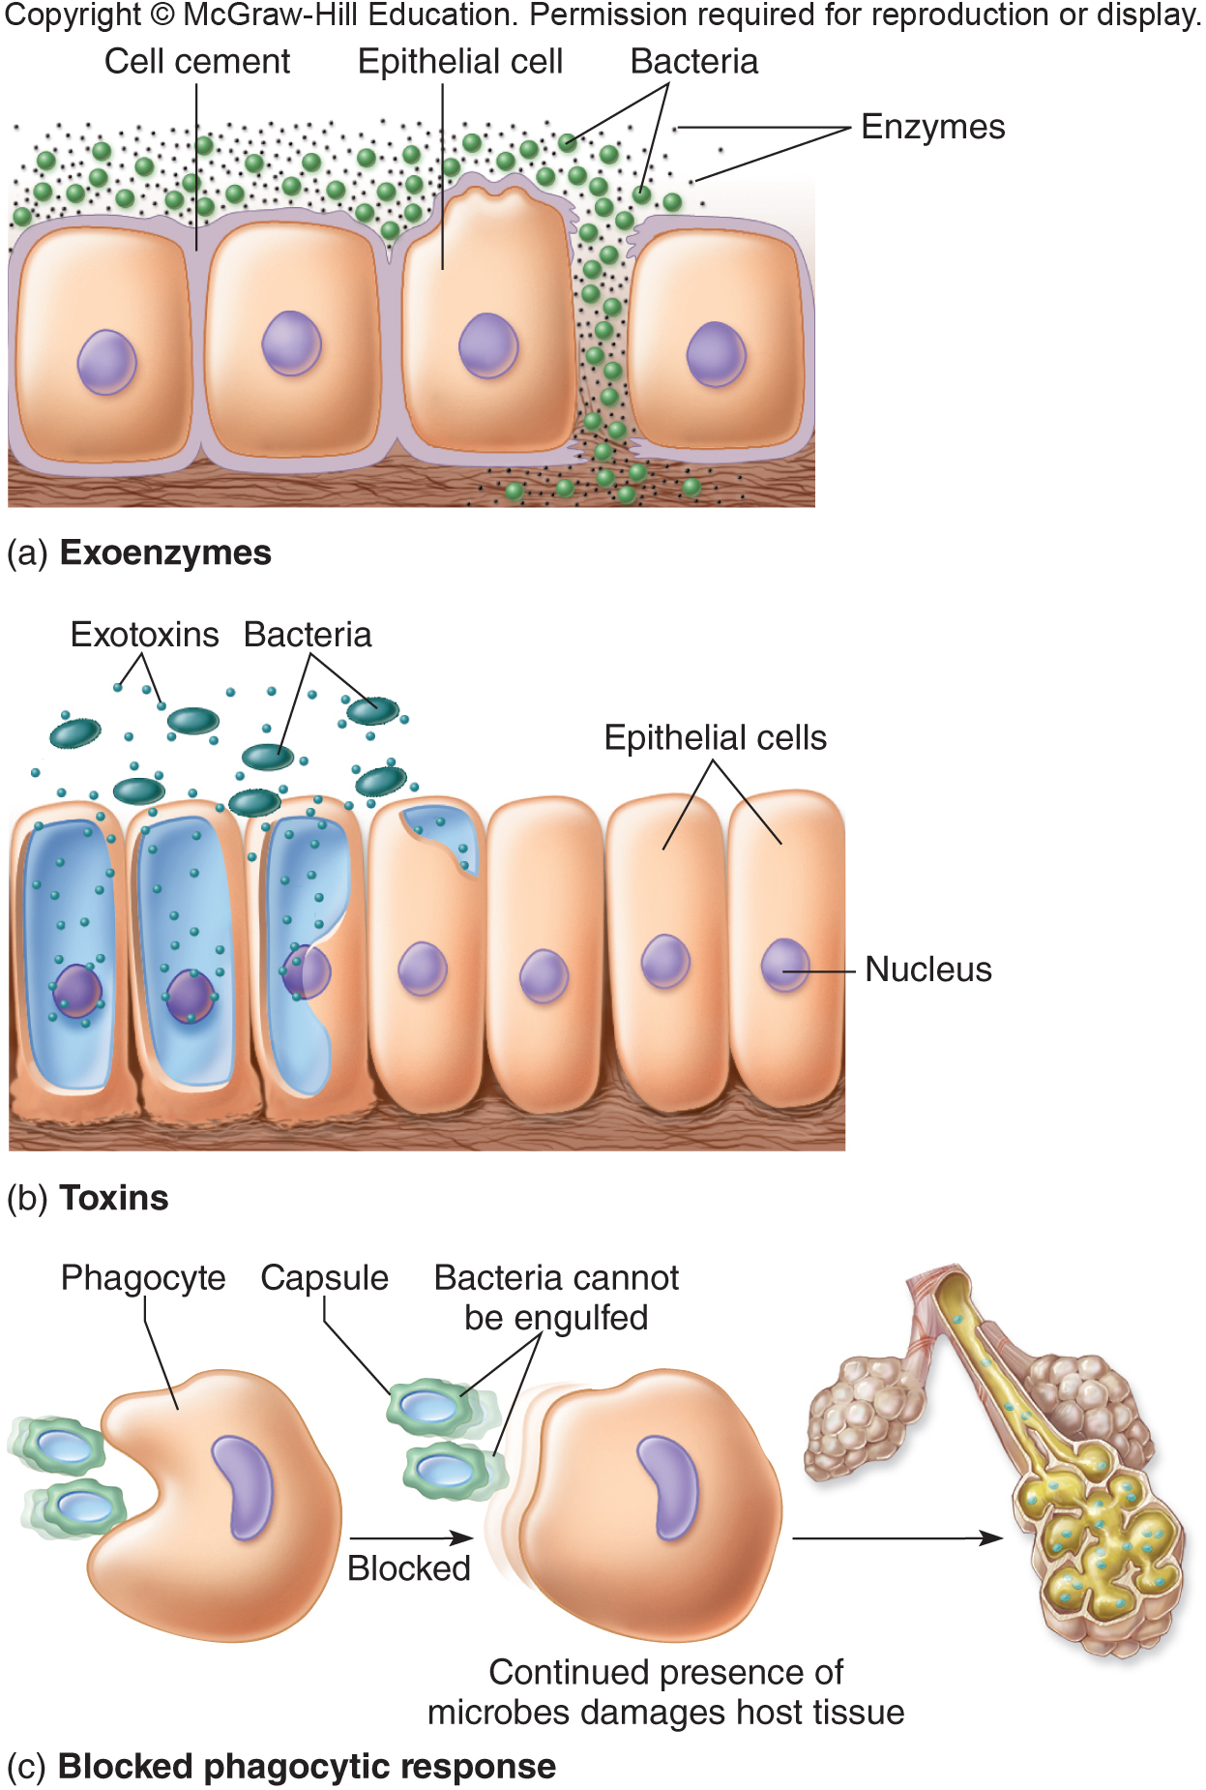
Extracellular Enzymes
Exoenzymes:
Secreted by pathogenic bacteria, fungi, protozoa, and worms
Break down and inflict damage on tissues
Dissolve host’s defense barriers and promote the spread of microbes into deeper tissues
Mucinase
Keratinase
Collagenase
Hyaluronidase

Slide 35
Bacterial Toxins: A Potent Source of Cellular Damage
Toxin:
Poisonous substance
Exotoxin:
Secreted by a living bacterial cell to the infected tissues
Many types
Endotoxin:
Shed from the outer membrane when microbe is damaged
Only found in gram-negative bacteria

Slide 36
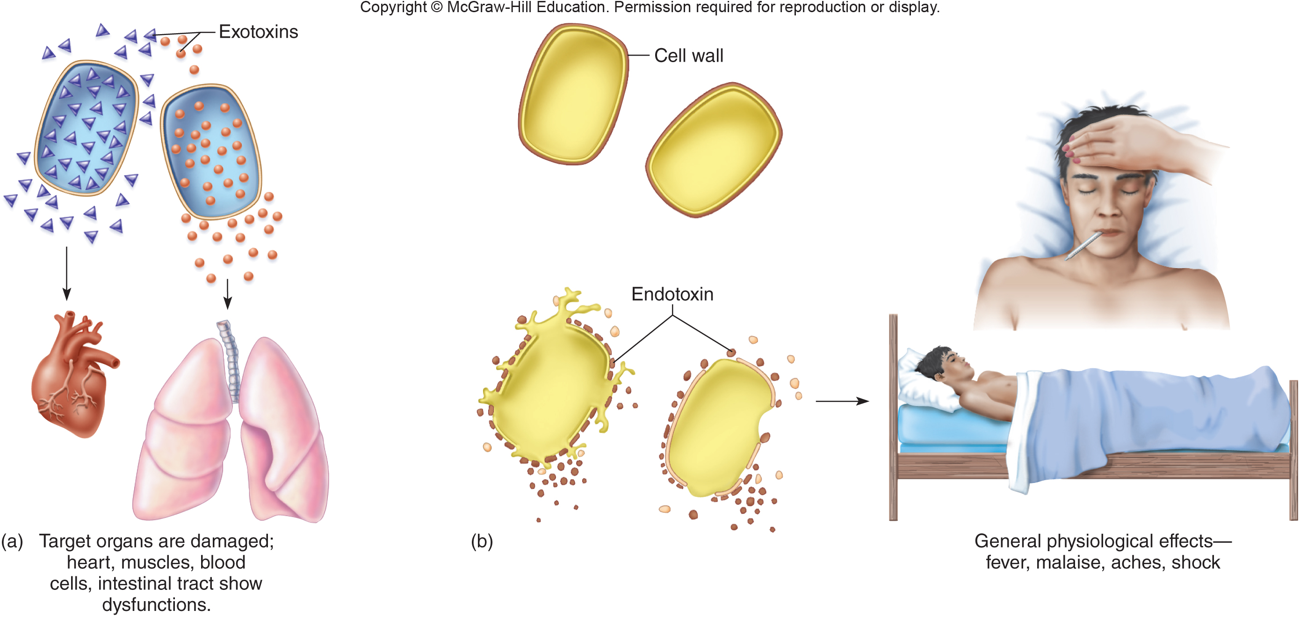
Bacterial Toxins

Slide 37
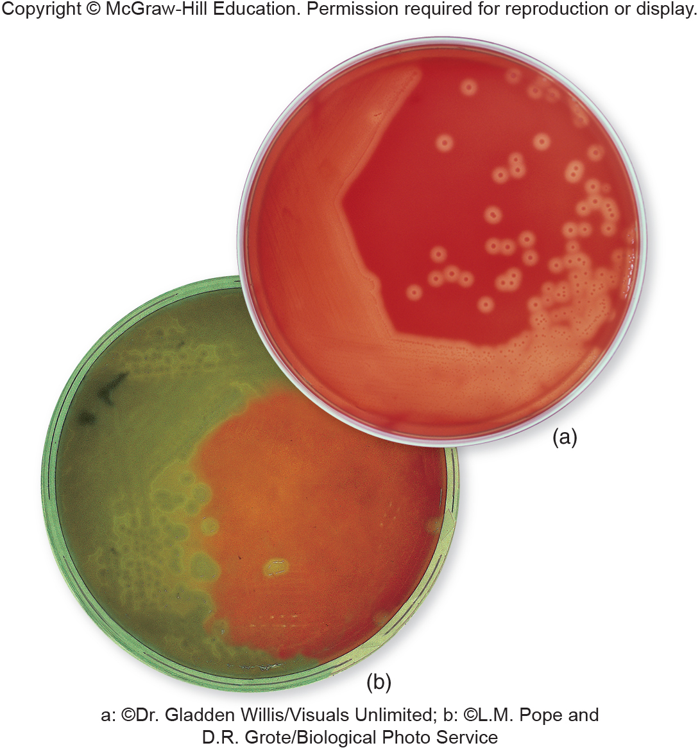
Bacterial Toxins

Slide 38
Inducing an Injurious Host Response
Many cases of microbial diseases are the result of indirect damage.
Host’s excessive or inappropriate response to a microorganism
Pathogenicity is a trait not solely determined by microorganisms
Consequence of an interplay between microbe and host

Slide 39
The Process of Infection and Disease
Microbes settle in a target organ and cause damage at the site.
Type and scope of injuries account for:
Typical stages of infection
Patterns of the infectious disease
Manifestation in the body

Slide 40
Patterns of Infection
Localized infection:
Microbe enters the body and remains confined to a specific tissue
Boils
Fungal skin infections
Warts

Slide 41
Patterns of Infection
Systemic infection:
When an infection spreads to several sites and tissue fluids, usually in the bloodstream.
Viral: measles, rubella, chickenpox, AIDS
Bacterial: brucellosis, anthrax, typhoid fever, syphilis
Fungal: histoplasmosis, cryptococcosis
Infectious agents can travel by means of nerves or cerebrospinal fluid

Slide 42
Patterns of Infection
Focal infection:
Exists when the infectious agent breaks loose from a local infection and is carried to other tissues
Examples:
Tuberculosis
Streptococcal pharyngitis: scarlet fever
Toxemia: infection remains localized, toxins are carried through the blood to the target tissue

Slide 43
Patterns of Infection
Mixed infection:
Several agents establish themselves simultaneously at the infection site
In synergistic infections, microbes cooperate in breaking down tissue
In other mixed infections, one microbe creates an environment that enables another microbe to invade

Slide 44
Patterns of Infection
Primary infection:
Initial infection
Secondary infection:
Occurs when a primary infection is complicated by another infection caused by a different microbe
Acute infections:
Come on rapidly
Have short-lived effects
Chronic infections:
Progress and persist over a long period of time

Slide 45
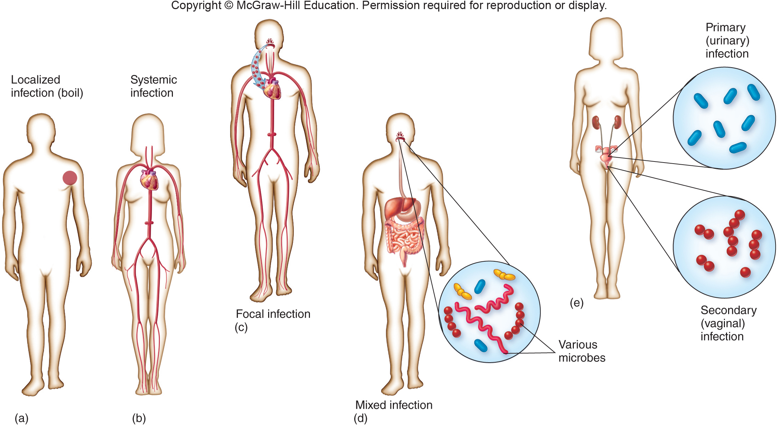
Patterns of Infection

Slide 46
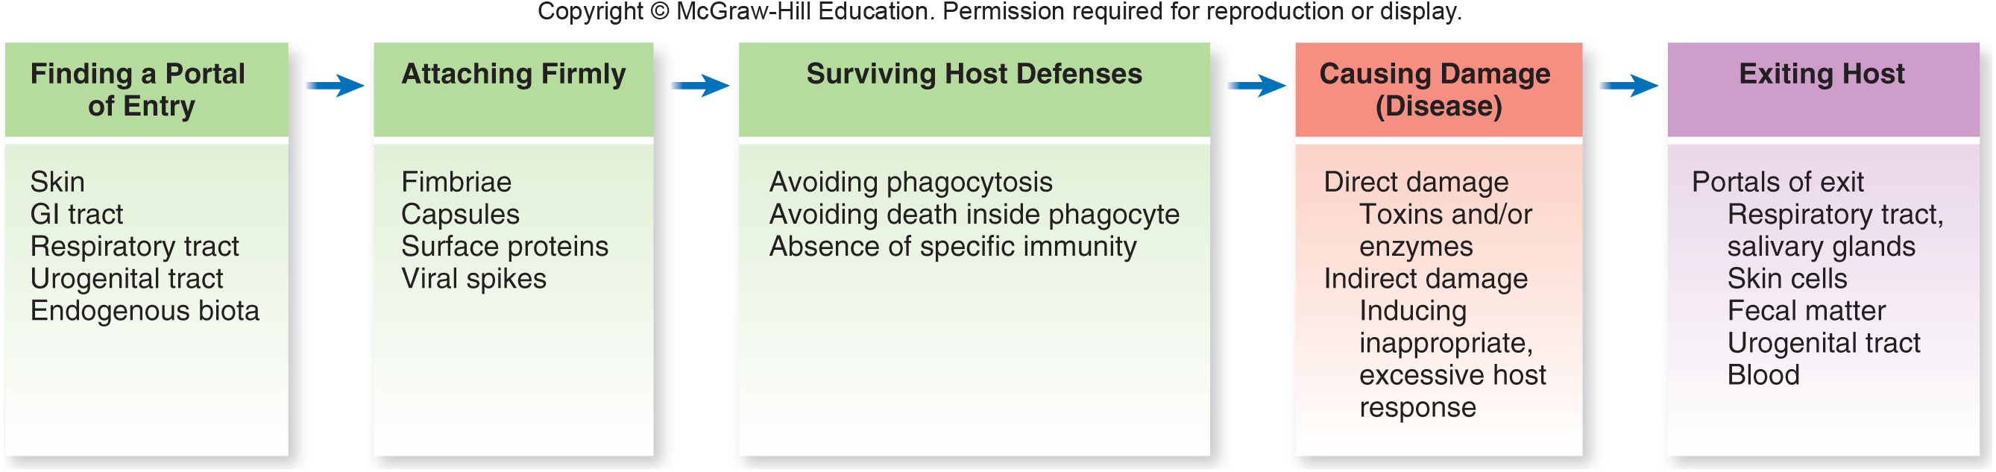
Patterns of Infection

Slide 47
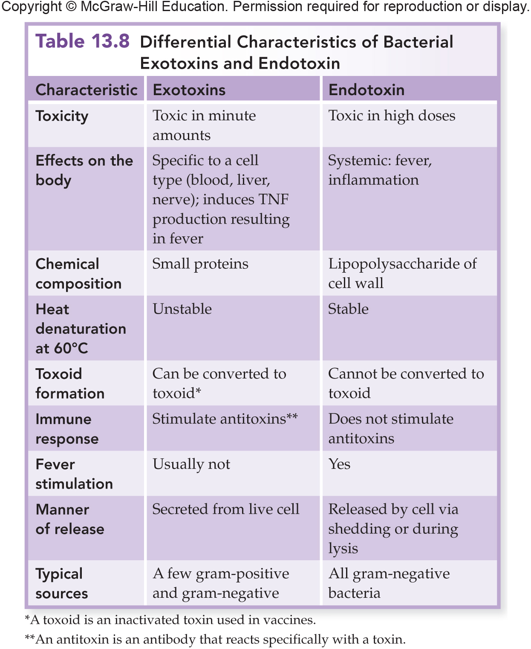
Bacterial Toxins

Slide 48
Signs and Symptoms: Warning Signals of Disease
Sign:
Any objective evidence of disease as noted by an observer
Symptom:
Subjective evidence of disease as sensed by the patient
Syndrome:
A disease identified or defined by a certain complex of signs and symptoms

Slide 49
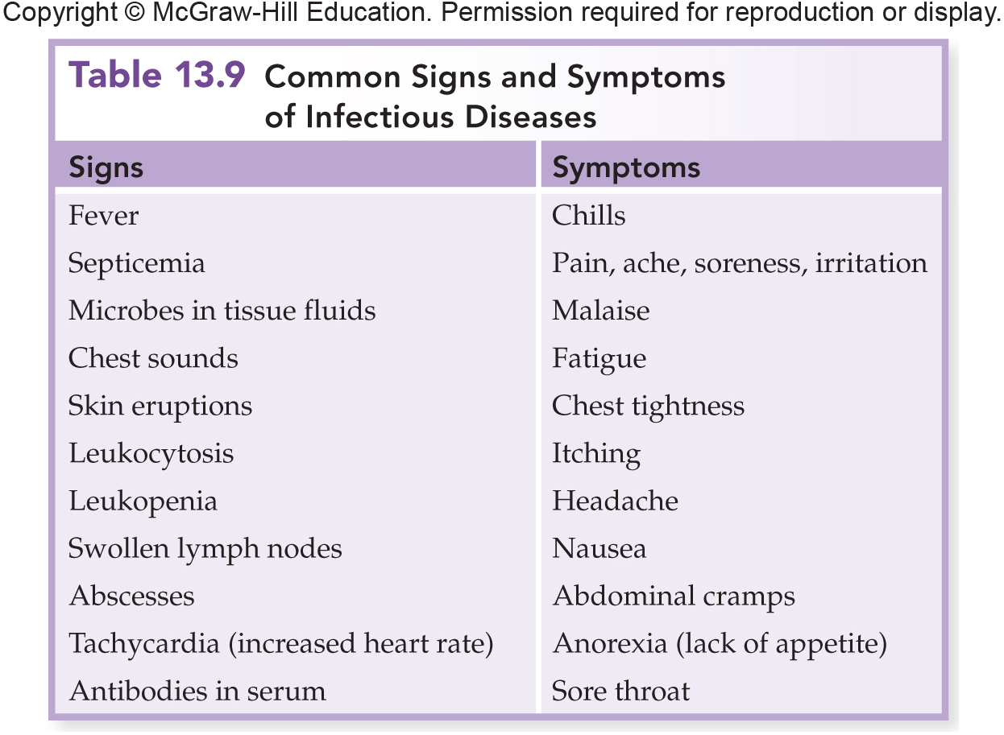
Signs and Symptoms: Warning Signals of Disease

Slide 50
Signs and Symptoms of Inflammation
Inflammation:
Earliest symptom of disease
Edema:
Accumulation of fluid in afflicted tissue
Granulomas and Abscesses:
Walled-off collections of inflammatory cells and microbes in the tissues
Lymphadenitis:
Swollen lymph nodes

Slide 51
Signs of Infection in the Blood
Leukocytosis:
Increase in the level of white blood cells
Leukopenia:
Decrease in the level of white blood cells
Septicemia:
General state in which microbes are multiplying in the blood and are present in large numbers

Slide 52
Signs of Infection in the Blood
Bacteremia:
Small numbers of bacteria are present in the blood but not multiplying
Viremia:
Presence of viruses in the blood, whether or not they are actively multiplying

Slide 53
Infections That Go Unnoticed
Asymptomatic, subclinical, or inapparent infections:
Host is infected but does not show symptoms of disease

Slide 54
Vacating the Host: Step Five – Portals of Exit
Portal of exit:
Pathogens exit the host
Secretion
Excretion
Discharge
Sloughed tissue

Slide 55
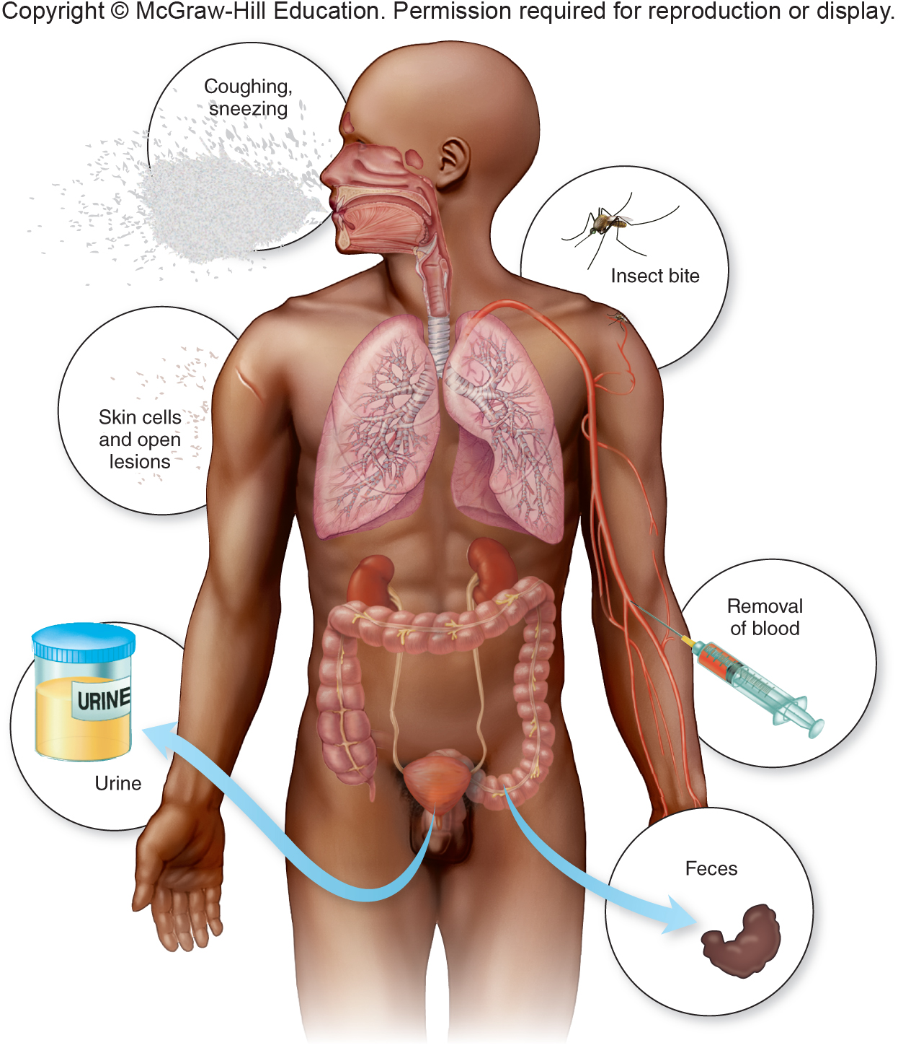
Vacating the Host: Step Five – Portals of Exit

Slide 56
Respiratory and Salivary
Escape media for pathogens that infect the upper and lower respiratory tract:
Mucus
Sputum
Nasal drainage
Moist secretions

Slide 57
Skin Scales
The outer layer of skin and scalp is constantly being shed
Household dust is composed of skin cells
A single person can shed several billion skin cells a day

Slide 58
Fecal Exit
Some intestinal pathogens cause irritation in the intestinal mucosa that increases the motility of the bowel.
Diarrhea - rapid exit for the pathogen
Helminth worms - release eggs and cysts through the stool
Feces containing pathogens creates a public health problem

Slide 59
Urogenital Tract
Agents involved in STIs leave the host in vaginal discharge or semen.
Source of neonatal infections during birth.
Herpes simplex
Chlamydia
Candida albicans

Slide 60
Blood
Pathogen is released when blood is removed or released through vascular puncture.
Blood-feeding animals are the most common transmitters of pathogens:
Ticks
Fleas
Mosquitoes

Slide 61
The Persistence of Microbes and Pathologic Conditions
Latency:
A dormant state of an infectious agent
Microbe can become active and produce recurrent disease
Sequelae:
Long-term or permanent damage to organs and tissues

Slide 62
What Happens in Your Body
Incubation period:
The time from initial contact with the infectious agent to the appearance of first symptoms
Prodromal period:
When the earliest notable symptoms of infection appear
Period of invasion:
Infectious agent multiplies at high levels and exhibits greatest virulence
Convalescent stage:
Patient responds to infection and symptoms decline

Slide 63
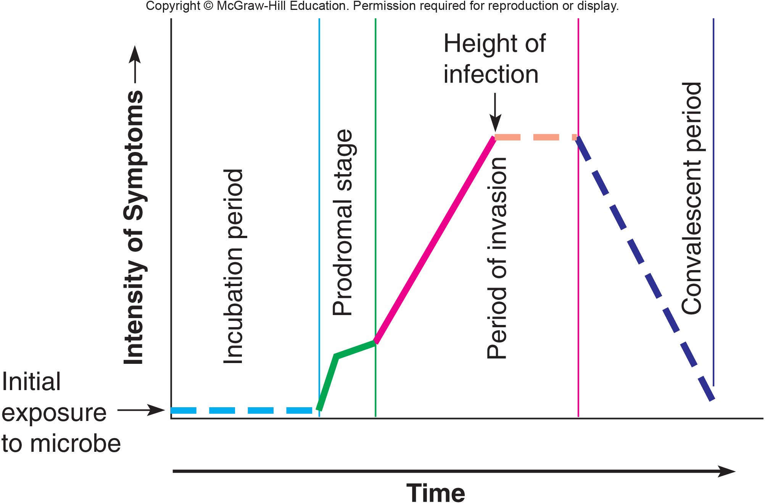
What Happens in Your Body

Slide 64
Reservoirs: Where Pathogens Persist
Reservoir:
A permanent place for an infectious agent to reside
Source:
Individual or object from which the infection is acquired
Carrier:
An individual who inconspicuously shelters a pathogen and can spread it to others without knowing

Slide 65
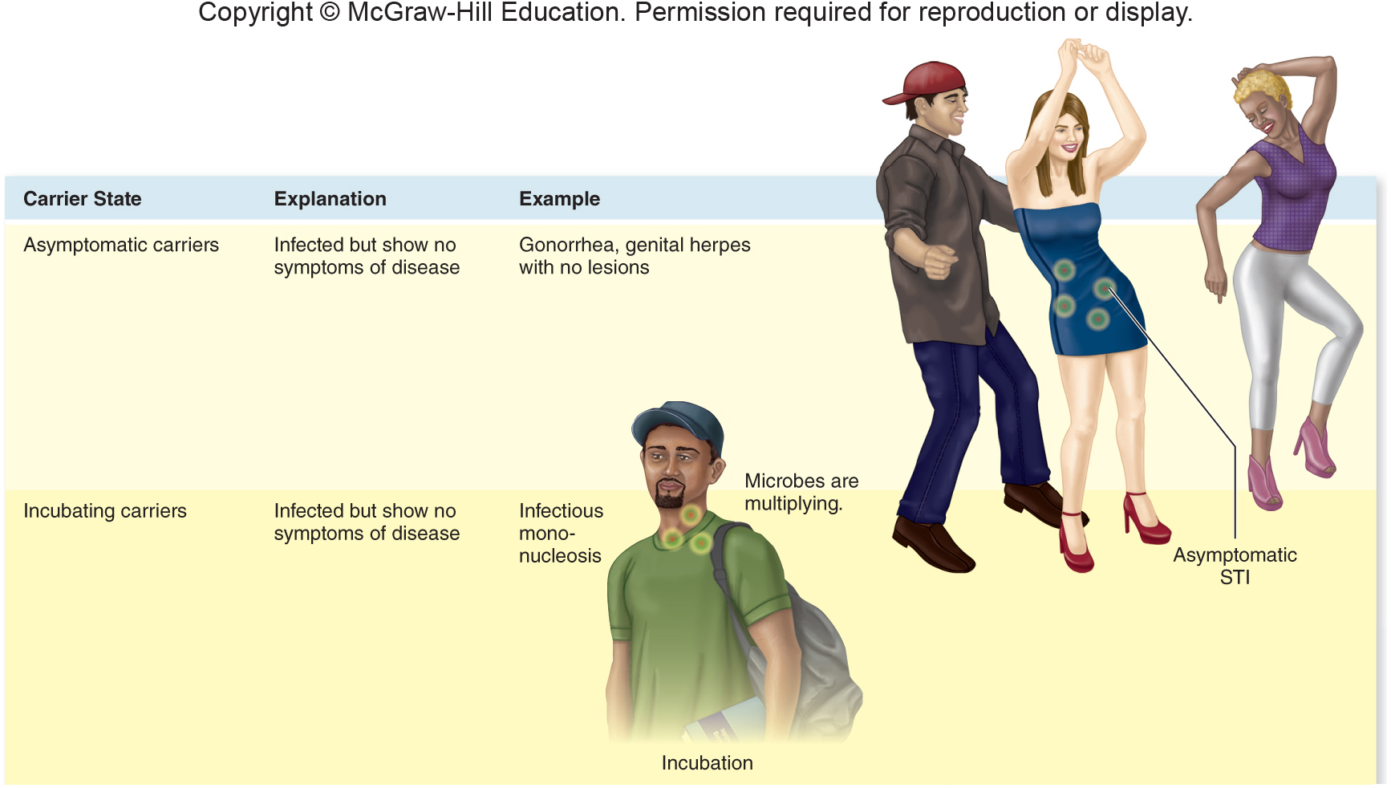
Living Reservoirs

Slide 66
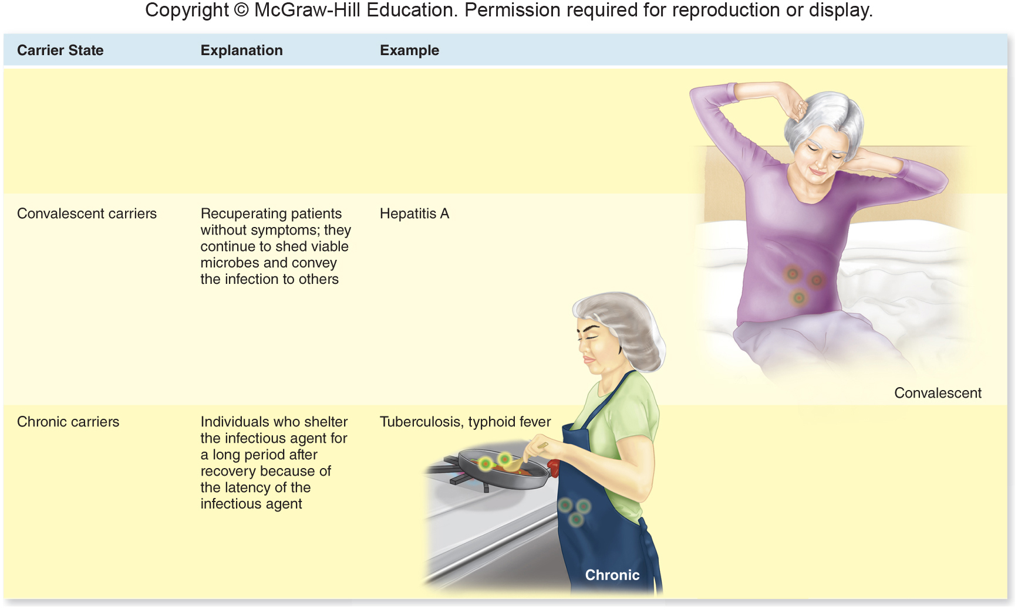
Living Reservoirs

Slide 67
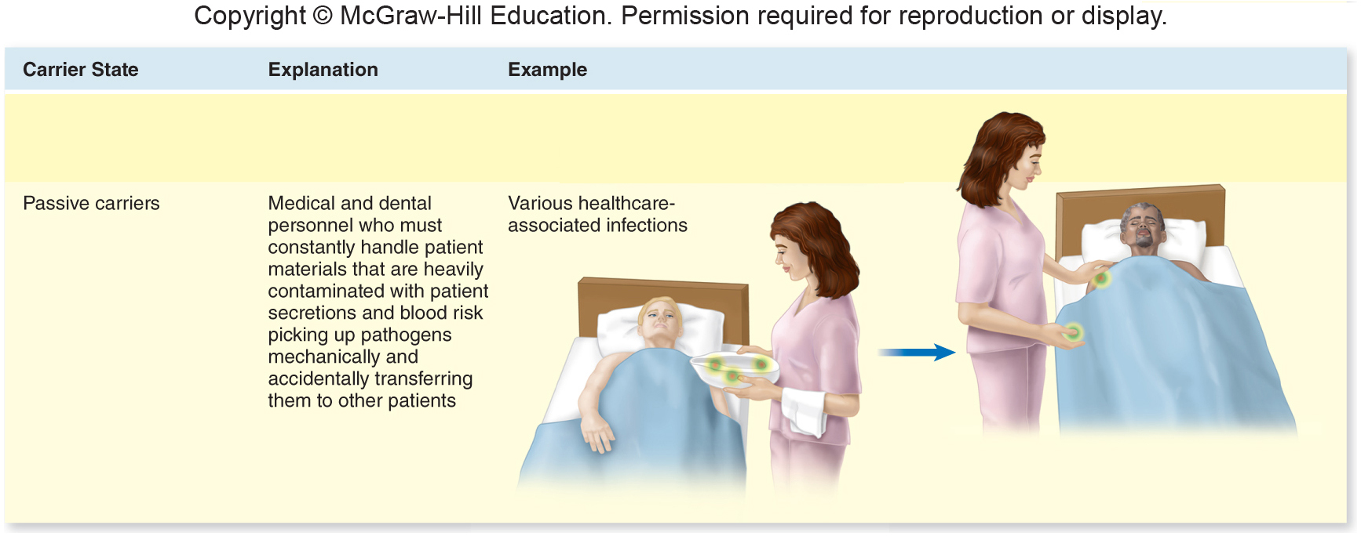
Living Reservoirs

Slide 68
Animals as Reservoirs and Sources
Vector:
A live animal that transmits an infectious agent from one host to another
Majority of vectors are arthropods:
Biological vector:
Actively participates in a pathogen’s life cycle
Serves as a site in which it can multiply or complete its life cycle
Mechanical vectors:
Not necessary to the life cycle of an infectious agent
Merely transport it without being infected

Slide 69
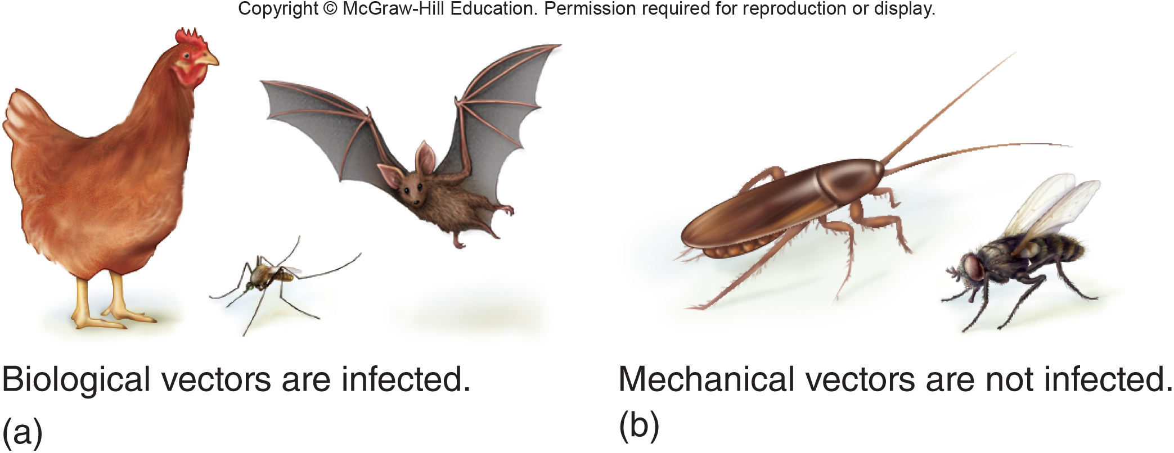
Animals as Reservoirs and Sources

Slide 70
Animals as Reservoirs and Sources
Zoonosis:
An infection indigenous to animals but naturally transmissible to humans
Human does not contribute to the natural persistence of the microbe
Spread of disease is promoted by close associations of humans with animals

Slide 71
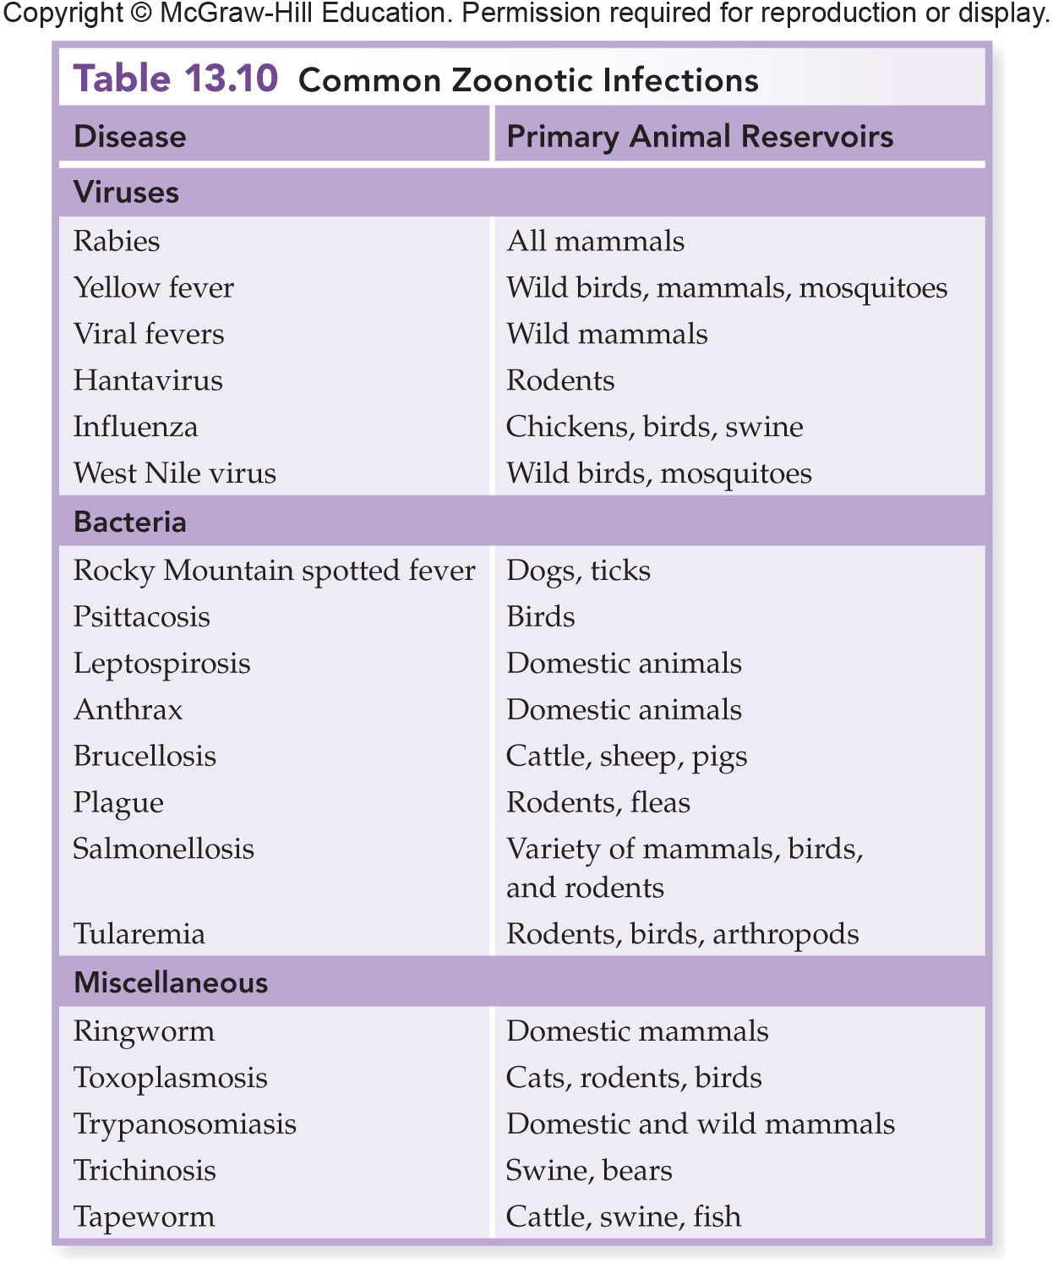
Animals as Reservoirs and Sources

Slide 72
Nonliving Reservoirs
Microbes have adapted to nearly every habitat in the biosphere.
Soil, water, and air
Most are saprobic and cause little harm to humans
Some are opportunists
A few are regular pathogens

Slide 73
The Acquisition and Transmission of Infectious Agents
Communicable disease:
Occurs when an infected host can transmit the infectious agent to another host and establish infection in that host
Contagious:
The agent is highly communicable, especially through direct contact
Noncommunicable:
Does not arise through transmission of the infectious agent from host to host

Slide 74
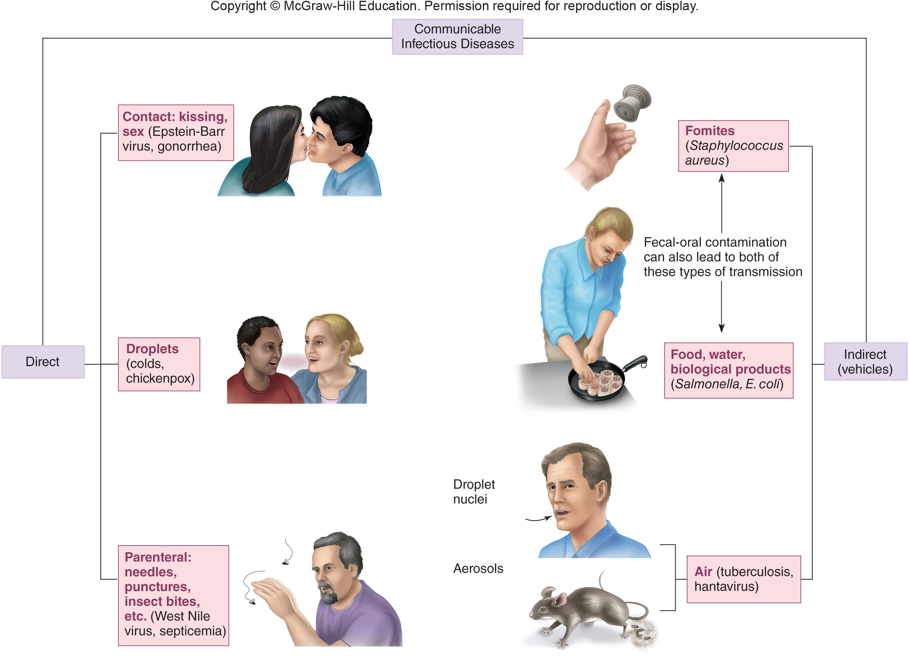
Patterns of Transmission in Communicable Diseases
Direct Contact
Touching
Kissing
Sexual Intercourse
Vertical Transmission
Prenatal – across placenta
Perinatal – during childbirth

Slide 75
Indirect Spread by Vehicles: Fomites
Vehicle:
Any inanimate material commonly used by humans that can transmit infectious agents
Fomite:
An inanimate object that harbors and transmits pathogens
Not a continuous source of infection

Slide 76
Indirect Spread by Vehicles
Oral-fecal route:
Fecal carrier with inadequate personal hygiene contaminates food during handling, and an unsuspecting person ingests it
Hepatitis A
Amoebic dysentery
Shigellosis
Typhoid fever

Slide 77
Water, Soil, and Air as Vehicles
Water and soil may harbor pathogens:
Can also become temporarily contaminated with pathogens that come from humans
Air:
Indoor air can serve as a support medium for the suspension and dispersal of respiratory pathogens via droplet nuclei and aerosols

Slide 78
Water, Soil, and Air as Vehicles
Droplet nuclei:
Dried microscopic residues created when microscopic pellets of mucus and saliva are ejected from the mouth and nose
Aerosols:
Suspensions of fine dust or moisture particles in the air that contain live pathogens

Slide 79
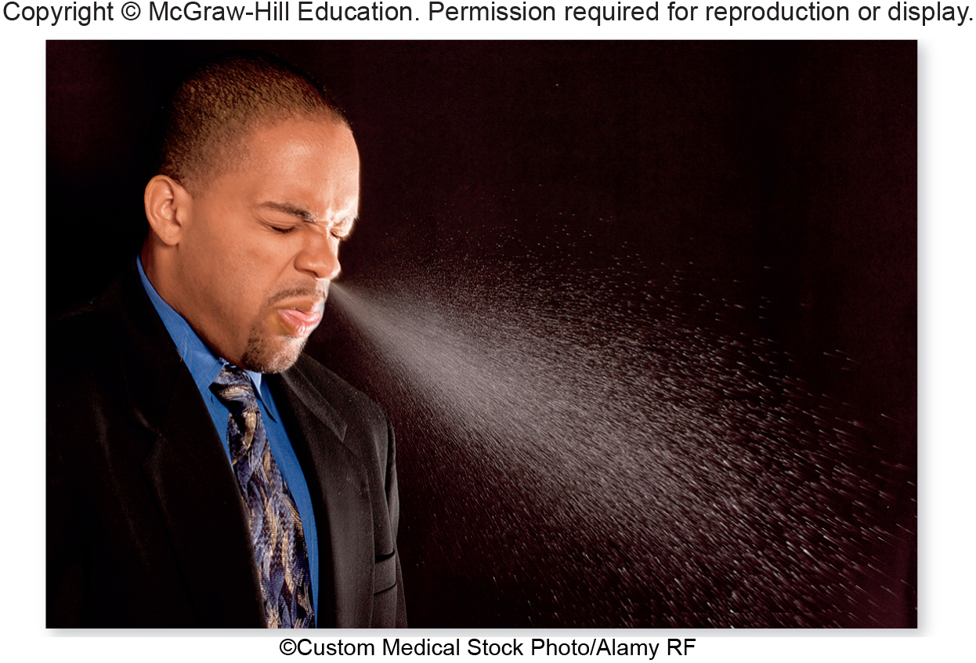
Water, Soil, and Air as Vehicles

Slide 80
Healthcare-Associated Infections
Healthcare-associated infections (HAIs):
Nosocomial Infections
Infectious diseases that are acquired or develop during a hospital stay or stay in another health care facility
Rates of HAIs can range from 0.1 – 20% of all admitted patients

Slide 81
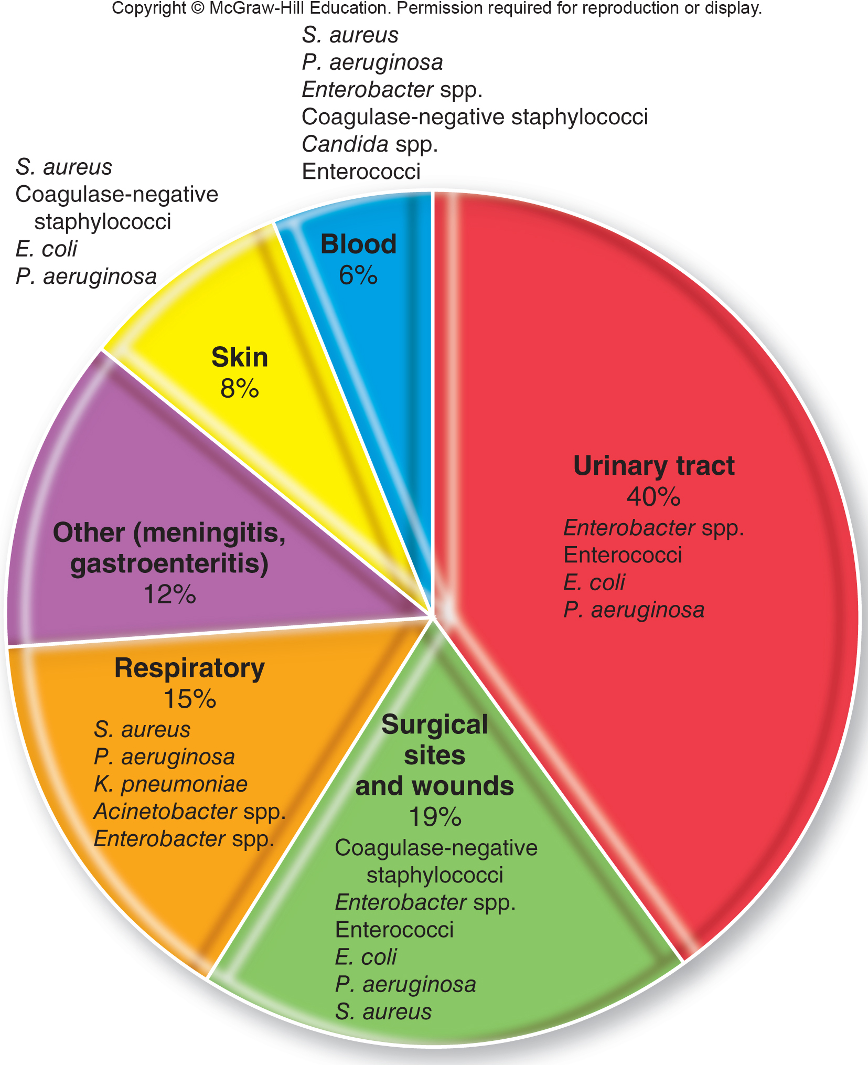
Healthcare-Associated Infections

Slide 82
Healthcare-Associated Infections
Medical asepsis:
Goal: limit the spread of infectious agents from person to person
Surgical asepsis:
Ensuring all surgical procedures are conducted under sterile conditions

Slide 83
Healthcare-Associated Infections
Infection control officer:
Implements proper practices and procedures throughout the hospital
Charged with:
Tracking potential outbreaks
Identifying breaches in asepsis
Training other healthcare workers in aseptic technique

Slide 84
Universal Precautions
Universal Precautions (UPs):
Barrier precautions
Needlestick precautions
Precautions with dental handpieces
Decontamination after hands and surfaces have been contaminated with blood and other fluids
Healthcare workers with active, draining skin or mucous membrane lesions must refrain from handling patients

Slide 85
Using Koch’s Postulates to Determine Etiology
Essential aim of the study of infection and disease is determining the etiologic agent (causative agent).

Slide 86
Using Koch’s Postulates to Determine Etiology
Robert Koch:
Developed a standard for determining causation of disease that stood the test of scientific scrutiny
Determined the causative agent of anthrax
Koch’s postulates:
A series of proofs that established the principal criteria for etiologic studies

Slide 87
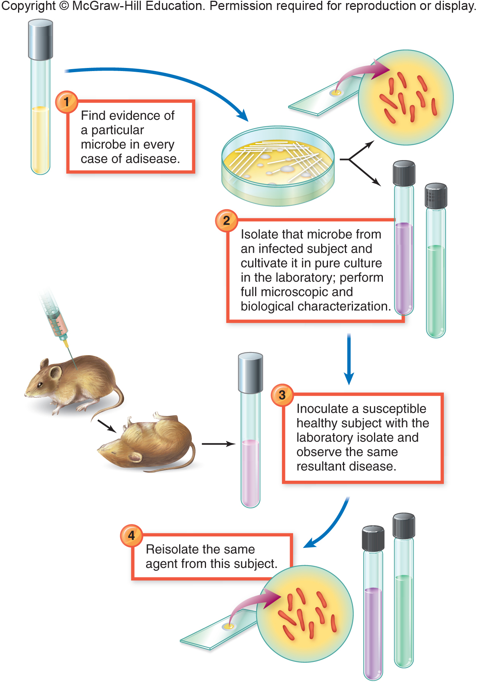
Koch’s Postulates:

