Slide 1
Amino Acid Sequence Analysis of Cytochrome C in Bacteria and Eukarya Using Bioinformatics
Notes:
For General Biology class for majors

Slide 2
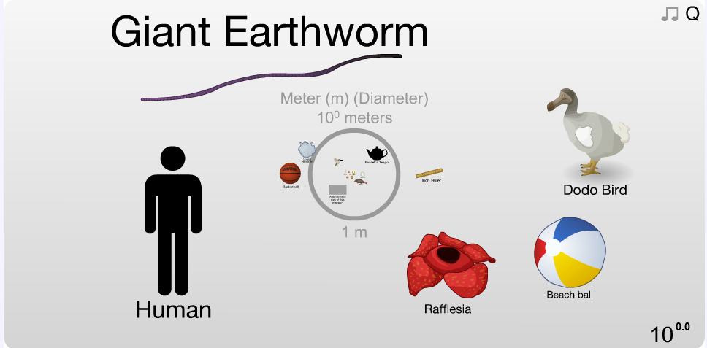
We live in a human-centric world.
Notes:
We are often focused on ourselves. In fact, we view most of the world from our perspective which is why we live in a human-centric world.
Yet, humans are just a small fraction in the whole universe. There is a large scale; things so small and too large to even imagine. You go from our size (order of meters) all the way down to the microscopic world. Even to smaller than an atom (smaller than nanometers!)! Alternatively, you can get really large … to the moon … pluto and beyond our universe and even galaxy.
Here is an interactive website that can move you through the scale of small to large.
http://apod.nasa.gov/apod/ap120312.html

Slide 3
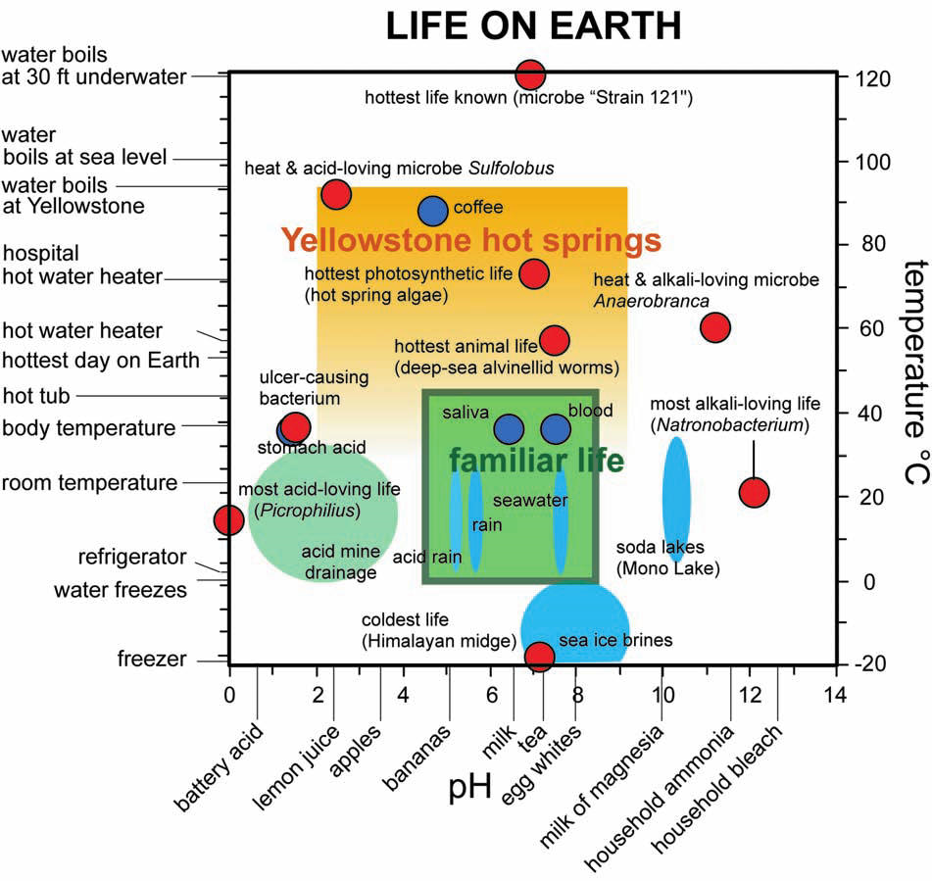
Life exists outside our box.
Subtitle
Text
Shock & Holland (2007)
Notes:
Well, not all organisms live inside our “little green box” or our ideal conditions.
What the point of this slide is: Life exists outside of our view of what life is.
Some aspects that you can point out:
pH range from 0 to 14 very acidic to very alkaline
Temperature on the right and left
Very cold to very hot and very acidic to very alkaline
Familiar life in the green box—things we know and recognize as habitats
Other environments:
Acid mine drainage
Sea ice brines
Yellowstone hot springs
Soda lakes in the Eastern Sierra
And then the red dots—they represent organisms that we’ve found
At temperatures of -20 to 120 C—doesn’t water boil at 100C? Yes, but these organisms are under pressure
Strain 121 is the world record holder actual has an optimal growing temperature (grows best) at 105 C and can still grow at 121. It was grown in a sterilizer (autoclave) the kind of system used to sterilize tools. This organism is not a pathogen—we’re not compatible with it. We’re not hot enough!
And at high salt, it acts like an antifreeze so organisms can live in -20 because the freezing point has been so far lowered
Even organisms that live in negative pH. You’ve probably never heard of negative pH, but the lowest measured is a minus 3.5 or 3.6 and remember that pH is a log scale, not linear. So there are 14 orders of magnitude difference.
Pretty remarkable the extent of microbial life.
Researchers focus on Yellowstone (Shock and Holland, 2007)
So, do you think ALL these organisms metabolize the same way? Do they also all need oxygen like we do? NO!
3

Slide 4
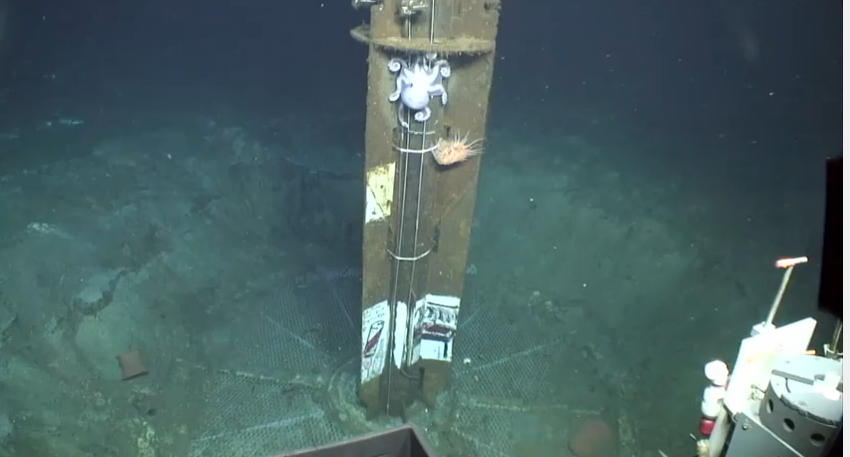
For example, there is life deep down on the ocean floor.
C-DEBI
(Center for Deep Energy Biosphere Investigations)
Notes:
Talk about CDEBI
Intro to C-DEBI video: https://www.youtube.com/watch?v=wiYzGL4iTY8&feature=youtu.be

Slide 5
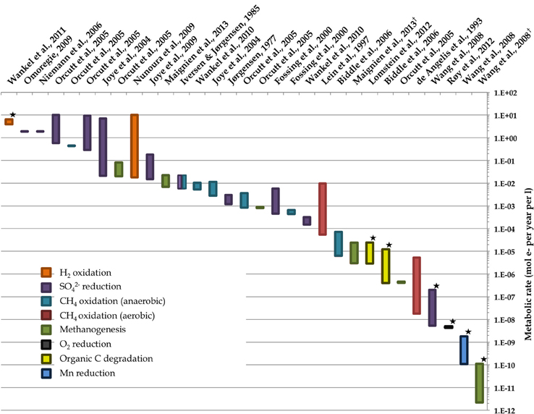
Do these different organisms all metabolize in the same way?
No!
Some are aerobic or anaerobic
Some use sulfur, iron, carbon or oxygen
Some are slower
BUT ….
Notes:
Discuss different forms of metabolism in bacteria
Here is a graph showing different organisms
http://www.darkenergybiosphere.org/research/images/T1_fmicb-04-00189-g002.jpg
(variety of metabolism for bacteria Representative ranges of microbial activity in the marine deep biosphere; Orcutt et al. 2013)
X-axis is the different studies looking at the different organisms.
Y-axis is the rate of metabolism. Metabolism works very slowly in the deep ocean
Color is the different sources used for metabolism

Slide 6
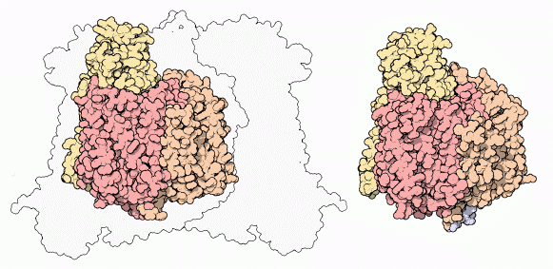
Cytochrome C suggests similarities in metabolism
Cytochrome C in eukaryotic mitochondria vs bacteria
Notes:
Explain overall role of cytochrome C
Compare cytochrome C in mitochondria vs. bacteria: On the left is a eukaryotic cytochrome C found in mitochondria. On the right is a bacterial cytochrome C. What do you notice about them? They both have the same core structure which may imply that there is a common function. This function is to help transfer electrons from one carrier to another. For example, in humans, the electron is ultimately being transferred to oxygen.
Background reading:
http://www.rcsb.org/pdb/101/motm.do?momID=5
Evolution of an Enzyme
Oxygen is consumed in special compartments inside our cells, termed mitochondria. When looking in the electron microscope, mitochondria bear an uncanny resemblance to simple bacteria. Today, many biologists believe that mitochondria are actually the result of a bacterial invasion sometime in the distant past. A bacterium squeezed inside another cell, but didn't kill the cell in the process. Instead they lived peacefully together. When the cell divided, the bacteria inside did too, so both daughter cells had bacterial invaders as well. Over many generations, the two became totally dependent on one another. The bacteria inside specialized on energy production and the cell provided protection and nutrients. Today, these bacteria are our mitochondria. Evidence of this symbiotic relationship is found in cytochrome c oxidase. The enzyme from mammals is very complex, composed of 13 separate protein chains (the cow enzyme is shown here, from PDB entry 1oco). Three large chains at the core of the enzyme, colored yellow, orange and red here, perform most of the work. Around this are ten smaller chains, colored in greens and blues.
If we look at the cytochrome c oxidase made by a bacterium, PDB entry 1qle shown here on the right, it is much simpler. It is composed of only four chains. Three are similar to the core chains in our enzyme, colored yellow, orange, and red. One additional small chain can just be seen poking out the bottom here, in blue. Notice how similar this enzyme is to the core of the mammalian enzyme, shown on the left. This similarity is compelling, but the story is even more interesting. Our mitochondria actually contain all of the machinery needed to build their own proteins--they have DNA, ribosomes, and everything. In our cells, the three core subunits of cytochrome c oxidase are built inside our mitochondria, but the remaining ten small chains are built outside in the cytoplasm and then added to the mitochondria later. So, our mitochondria build a bacteria-like enzyme, which our cells then decorate with other proteins to customize its function.

Slide 7
Today’s activity objectives are
Understand and use bioinformatics.
Compare and contrast cytochrome C in humans, other animals and bacteria.
Relate cytochrome C from various species to genome evolution and protein function.
Notes:
Full statements written in activity:
Purpose:
Understand and use bioinformatics with the programs BLAST and Seaview.
Compare and contrast amino acid sequences of cytochrome C in humans, other animals and bacteria.
Relate amino acid sequences of cytochrome C from various species to genome evolution and protein function.

Slide 8
Hypotheses
Shared ancestry → common amino acid sequences in cytochrome C
Similar metabolism function → common amino acid sequences in cytochrome C
Notes:
Full statements written in activity:
Hypotheses:
Organisms that are more closely related will share more common amino acid sequences in the cytochrome C protein.
Organisms with similar types of metabolism will share more common amino acid sequences in the cytochrome C protein.

Slide 9
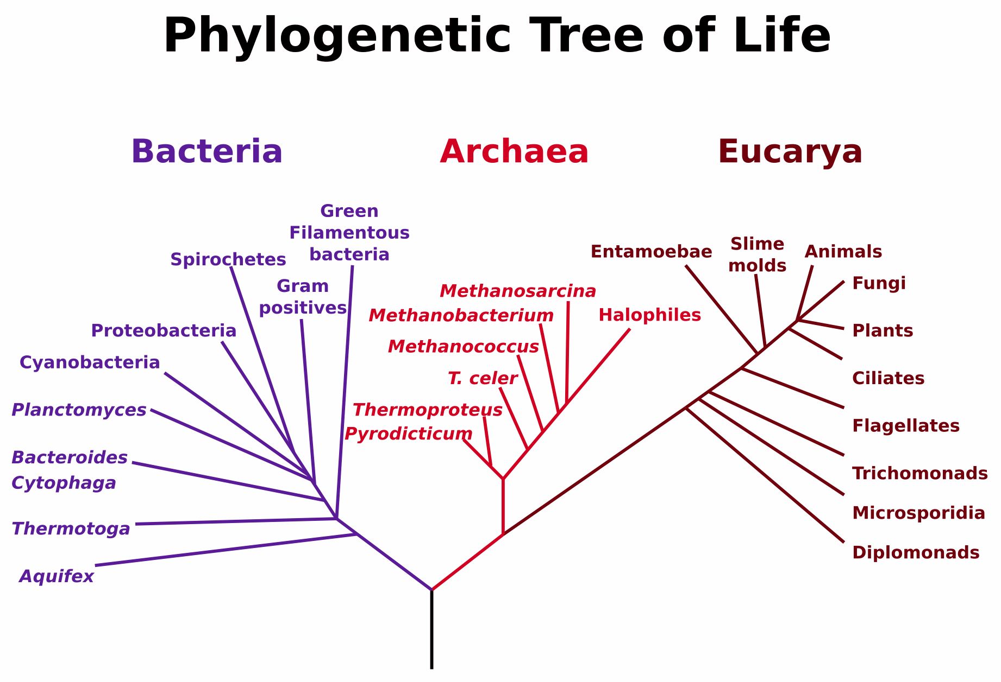
Our subjects
Notes:
3 domains of life. We will look at Bacteria and Eukarya.

Slide 10
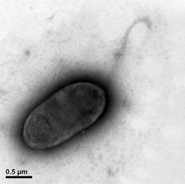
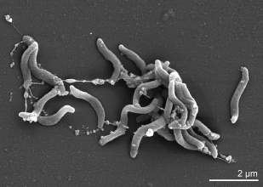

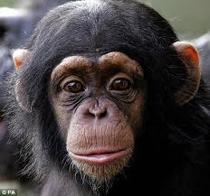
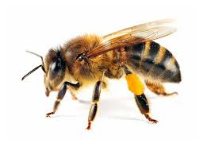
Our subjects
2 bacteria: prokaryotes that live in the deep ocean
Sphingomonas: aerobic, eats anything!
Caldithrix abyssi: anaerobic, hot thermal vents
3 eukaryotes: humans, chimps, dolphins and bees
Homo Sapiens
Pan Troglodytes
Apis mellifera
Notes:
Who is most similar? Who is most different?
All the eukaryotes are most similar. They all have mitochrondria where cytochrome C is located and all use oxygen as the final electron acceptor.
The bacteria, Caldithrix abyssi, is the most different because it is not aerobic. Instead of using oxygen, it uses nitrogen as the final electron acceptor.

Slide 11
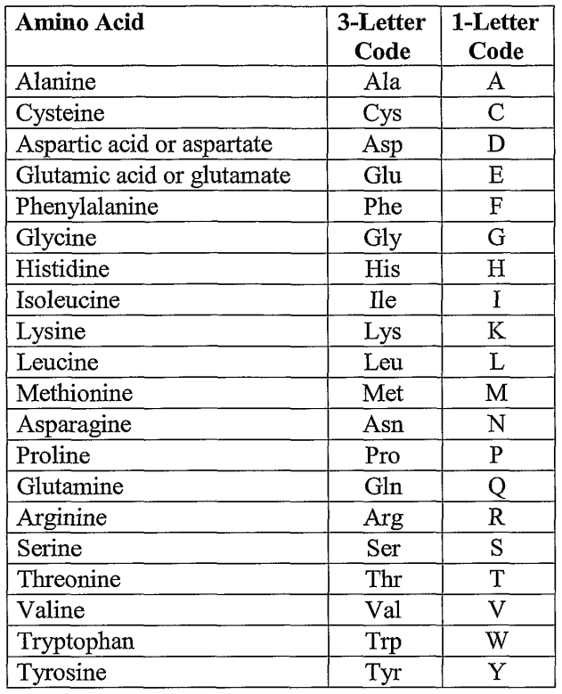
Amino Acids Sequences Make Up Cytochrome C Protein
MGDIEKGKKIFVQKCAQCHTVEKGGKHKTGPNLHGLFGRKTGQAVGFSYTDANKNKGITWGEETLMEYLENPKKYIPGTKMIFAGIKKKSERADLIAYLKKATNE
Cytochrome C
Species
Notes:
Amino acid sequences make up the cytochrome C protein. We will look to see if different species have different amino acid sequences. If so, then that suggests differences in their cytochrome C function.
Recall that there are 20 amino acids that can be used to make up proteins. These are the same no matter what the species is. It’s the same for humans, chimps, bees and bacteria. Amino acids have abbreviations. We have used 3 letter abbreviations so far, but that is still too long when you are dealing with sequences that are over 100 amino acids. So, there is an even shorter 1 letter abbreviation code. This is what is shown on the table here, which you have in your appendix. For instance, the first amino acid in this chain is “M”. What does “M” stand for? Go to the table and you find that “M” is for Methionine, which is always the starting amino acid.

Slide 12
Start Comparing Sequences!
Three exercises (watch posted youtube videos)
BLAST: identify accuracy of given amino acid sequences (figure out unknown)
BLAST: compare amino acid sequences for cytochrome C between species
Sea View: visually align cytochrome C amino acid sequences for all 6 species
Notes:
Now, students can work on the 3 exercises.
Options for dividing students into groups:
Groups of 2. Each group goes through all 3 exercises (~2 hrs to complete all 3 exercises)
4 students (group A with 2 students & B with 2 students) (~1 hr to complete and share exercises)
All do #1: divide up organisms (both groups A&B do #1. unknown. Group A does 3 organisms while group B does the other 3 organisms)
Group A: do #2 exercise
Group B: do #3 exercise
Share your findings
All do discussion/conclusion.
Have students follow the appropriate videos as they complete each of the 3 exercises. It is best if they watch a part of the video, pause it, complete that task, then continue to the next part of the video.
Exercise 1 demonstration: http://youtu.be/yv7Tbo3XyOw
Exercise 2 demonstration: http://youtu.be/xY_FOkSfhu0
Exercise 3 demonstration: http://youtu.be/-XfF8sJaZ-c

Slide 13
Results
Exercise 1: Identify with BLAST
BLAST is accurate at identifying cytochrome C protein and the organism.
Notes:
This exercise is to get students familiar with BLAST and double check the validity of the sequences provided. This exercise confirms that the sequences we have are indeed for Cytochrome C and for the given organism listed.
Note: When BLAST runs, it identifies protein first by the common AA sequence (just the colored part). This is done fairly quickly for cytochrome C.
Then BLAST works on the other remaining parts of the sequence to find out what organism this protein belongs too (the other parts of protein). This takes a little longer to identify such as showing that a particular cytochrome C belongs to a human or a bee.
BLAST is fairly accurate at matching up sequences with protein and organisms as shown by the high percent for identity values.
All of these sequences match for cytochrome C (as expected)
Was the protein or organism identified first? What does this imply about genome evolution?
Gene for cytochrome C is conserved across organisms (bacteria, eukarya). There is a common conserved region which was located quickly. It took longer time to find the species because BLAST is searching for the differences in the sequences for each species.
Do your given sequences correctly identify the protein and organism? Explain using the data in table.
Yes, all searches matched cytochrome C protein with 100% accuracy. The sequences also matched with the correct organism identified with 100% identity value.

Slide 14
Results
Exercise 2: Compare species with BLAST
What does this table tell you about genome evolution?
Cytochrome C | Homo Sapiens | Pan troglodytes | Apis mellifera | Sphingo-monas | Caldithrix abyssi
Homo Sapiens | - | 94 | 75 | 52 | 30
Pan troglodytes (Clint) |  | - | 72 | 51 | 27
Apis mellifera |  |  | - | 54 | 27
Sphingomonas |  |  |  | - | 27
Caldithrix abyssi |  |  |  |  | -
Notes:
Exercise 2 shows the similarity between a human’s cytochrome C (Homo sapiens) to that of other eukaryotes (chimps, bees) and bacteria (Sphingomonas, Caldithrix abyssi)
Bacteria are only 27% similar to each other in AA sequence for cytochrome C.
We are more closely related to other eukaryotes as seen by the higher identify values (94, 75, 72%, avg 80%). We are not as closely related to bacteria as seen by the lower identity values (52% and 30%, avg 41%). However, since we do still have some similarity in cytochrome C with bacteria (52%, 30%), we do share a common ancestor.
Within bacteria (27%), they are more diverse than within Eukarya (~80%)
List in order the species that have cytochrome C that is the most similar to least similar to humans. What does this result imply about our evolutionary relationships with bacteria and other eukaryotes?
Chimp, dolphin, bee, Sphingomonas, Caldithrix abyssi (anaerobic)
We do have a shared ancestor with bacteria because there is some ID match, but this ancestor is in the distant past because there is a lower ID match.
Our shared ancestors are more recent with other Eukarya because there is a higher ID match.
What amino acid(s) are different between Homo sapiens and Pan troglodytes? Do you
think this difference has any effect on cytochrome C function? Briefly justify your answer.
Six differences in amino acids (99/105 similar)
No, there is probably no effect on cytochrome C function because humans and chimps likely have similar metabolic processes (breathe oxygen) to generate energy. These are likely silent mutations.

Slide 15
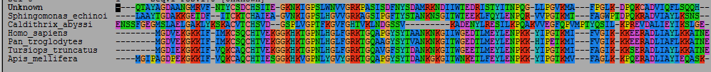
Results
Exercise 3: Visually align cytochrome C sequence with Seaview
What amino acids are conserved across species?
What is the significance?
Notes:
Use your alignment of cytochrome C sequences in SeaView to answer the following questions.
Which domain of life looks more diverse, bacteria or eukarya? Briefly explain your answer by pointing out patterns from the data.
Bacteria look more diverse because there are less aligned amino acids between the two bacteria than between the 4 eukaryotes.
Which species has the sequence that is the MOST different from the other species? Suggest a reason (based on protein function) why this species’ cytochrome C sequence might differ the most.
Calthidrix abyssi is the most different in amino acid sequence. This difference could be due to the different metabolic process that this bacteria uses. Instead of using oxygen as the electron acceptor, it uses nitrogen. All the eukaryotes and Sphingomonas all do aerobic respiration with oxygen.
a. List the name of amino acids that were identical in position in the cytochrome C sequence across all species investigated. The part of the genome that codes for these amino acids are referred to as “conserved regions” of the gene.
G (glycine) position 15, 39, 44, 47, 55
C (cysteine) position 24
H (histidine), position 28
P (proline), position 40, 81
b. What might be the function of these conserved regions for the cytochrome C protein?
All are involved in metabolism. We know cytochrome C in humans carries the electron in the electron transport chain to the final electron acceptor. These amino acids may be the electron carrier to the electron acceptor, the oxidizer (ie. oxygen, iron, sulfur)

Slide 16
Discussion
Do you support your hypotheses?
Notes:
Discuss with students how their data supports or rejects the hypotheses.
Yes, humans are aerobic (use oxygen) to metabolize. Therefore, the other organisms that also use aerobic metabolism should have the most similar amino acid sequences for cytochrome C. This is shown in that humans are closest to each other in metabolism function, then chimps, bees and Pseudonomas which all have aerobic metabolism. Therefore Homo sapiens 1 share 100%, 94%, 75% and 40% identity value respectively. Caldithrix abyssi has the least common metabolism function since it is anaerobic and indeed they share the least common sequence with humans with a 30% identity value. Therefore metabolism function (aerobic vs anaerobic) is reflected in the similarity of amino acid sequences.
Note: if group states “No” then that is acceptable as long as the data is used to back up the claim. Also, students can do all 3 hypotheses if there is time.

